Slide 1
Crisis Intervention and Trauma
Dr. Stephanie Van Deusen (She/Her)
www.svandeusenphd-stages.com
svandeusen@comcast.net

Slide 2
OUR COLLECTIVE STARTING POINT
Peace Prayer of Saint Francis
Lord, make me an instrument of your peace:
where there is hatred, let me sow love;
where there is injury, pardon;
where there is doubt, faith;
where there is despair, hope;
where there is darkness, light;
where there is sadness, joy.
O divine Master, grant that I may not so much seek
to be consoled as to console,
to be understood as to understand,
to be loved as to love.
For it is in giving that we receive,
it is in pardoning that we are pardoned,
and it is in dying that we are born to eternal life.
Amen.

Slide 3
INTRODUCTIONS
Share some of your demographics.
Where you are in the program?
Where are you currently working?
Word or metaphor that describes your life in the past 2 years.
What does it mean to you to be trauma-informed?

Slide 4
Trauma-Informed teaching environment
Consistency, routine, flexibility
Transparency about goals and expectations
Create physical safety in the room
Manage the risk of in-class triggers
Provide opportunities to use your voice and exercise choice
Build trust in relationships
Build community through student to student relationships
Help engage in a ”Growth Mindset”
Notes:
REVIEW THE SYLLABUS – ASSIGNMENTS, INTENTIONS, PACING

Slide 5
THE “WAYS PARADIGM” (CHESTON, 2000)
  Way of Being
  Way of Understanding
  Way of Intervening

Slide 6
Trauma defined
Trauma is the response to a deeply distressing or disturbing event that overwhelms an individual’s ability to cope, causes feelings of helplessness, diminishes their sense of self and their ability to feel a full range of emotions and experiences.

Slide 7
Common Responses And Symptoms Of Trauma
Emotional signs include:
  Sadness
  Anger
  Denial
  Fear
  Shame
These may lead to:
  Nightmares
  Insomnia
  Difficulty with relationships
  Emotional outbursts

Slide 8
Common Responses And Symptoms Of Trauma
Common physical symptoms:
  Nausea
  Dizziness
  Altered sleep patterns
  Changes in appetite
  Headaches
  Gastrointestinal problems
Psychological disorders may include:
  PTSD
  Depression
  Anxiety
  Dissociative disorders
  Substance abuse problems

Slide 9
Way of Understanding:
A Trauma-Informed Model
BEING INVITED under the trauma membrane comes as we pass tests regarding our knowledge concerning the trauma circumstance, and also pass tests of trustworthiness”
(Lindy & Wilson, 2001, p. 436)

Slide 10
Transactional Model vs. Linear Model
Individual
factors
Family
Factors
Environmental
factors
Trauma
Factors
Culture
Transient
Factors
Varied
Developmental
Impact
There are multiple pathways to adaptive and maladaptive developmental outcomes

Slide 11
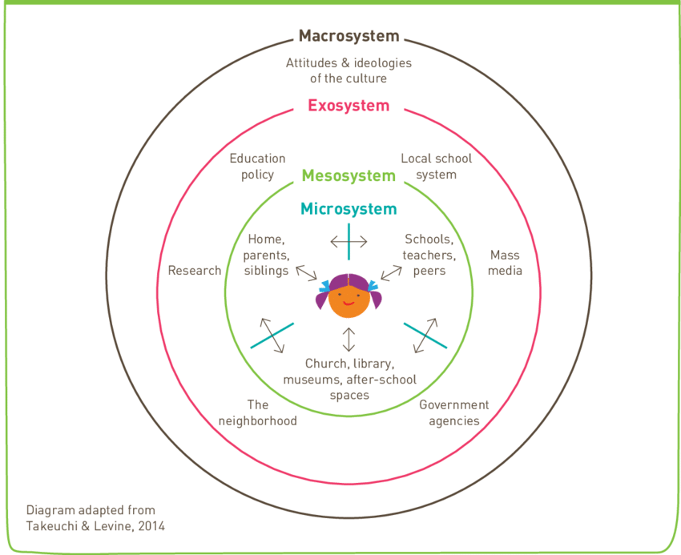
Bronfrenbrenner’s Ecological Systems theory
Notes:
Bronfrenbrenner’s theory on Ecological systems
Micro—child’s immediate surroundings
Meso—larger systems the child is involved in
Exosystem—the environmental settings that have an indirectly but profound influence on the child
Microsystem—Cultural context
Use dry erase board to draw this out in class

Slide 12
Trauma: Objective Dimensions
Structure of the Trauma
  Interpersonal vs. accidental
  Severity
  Duration/chronicity
  Life-threat
  Exposure to death/dying/horror
  Bereavement/loss
  Single vs. multiple stressor
  Potential for re-occurrence
  Complexity of the stressor
  Relationship issues
  Forced silence

Slide 13
Trauma: Objective Dimensions
Experience and complexity of the trauma
  Alone or with others
  Community-based or not
  Moral conflict
  Role in trauma and after
Post-trauma milieu
  Level of support/understanding
  Opportunity for ventilation/discussion
  Treatment availability and quality
  Cultural issues/rituals for recovery
  Societal attitudes

Slide 14
Trauma: Subjective Dimensions
Personal experience of the trauma
  Alone or with others
  Direct or indirect
  Community based
  Moral conflict/coercion
  Role in trauma and afterwards
  Multiple traumatic moments, during and after
  Changes in attention or concern
  Agency/effectiveness
  Peri-dissociation

Slide 15
Family Factors
Family’s support of the child post-maltreatment
  Acknowledgment of what happened
  Belief in the child
  Emotional support
  Ability to protect the child from further maltreatment
  Securing appropriate services
  Provision of adequate parenting

Slide 16
Family Factors (2)
Family functioning and parenting pre-maltreatment
  Attachment
  Marital security
  Individual functioning of parents
  Poverty, stability of residence, income; social network and support
  Single parent
  Discipline/parenting effectiveness and appropriateness

Slide 17
Characteristics of an Traumatic Environment
The pathological environment of childhood abuse forces the development of extraordinary capacities, both creative and destructive. It fosters the development of abnormal states of consciousness in which the ordinary relations of body and mind, reality and imagination, knowledge and memory no longer hold.
~ Judy Herman, 1992, p. 97
Totalitarian control
Pervasive terror
Secrecy
Isolation

Slide 18
Culture
“The shared values, traditions, arts, history, forklore, and institutions of a group of people that are unified by race, ethnicity, nationality, language, religious beliefs, spirituality, socioeconomic status, social class, sexual orientation, politics, gender, age, disability, or any other cohesive group variable.”
~ N.N. Singh, 1995
Trauma always happens within a context, and so does healing
Notes:
Etic – within group similiarities. Objective collections of information about a group based on catergories of analysis. Problematic.
Vs.
Emic models assume, not a stance of expertise on the part of the clinician, but a stance of curiousity and ignorance, an important foundation for culturally competent practice

Slide 19
Bias: yours, mine, and all of ours
“Evolutionary biology and psychology indicate that humans are coded to notice difference. Their limbic systems, also implicated in the trauma response, light up and become active when data become available that another human differs in some way…[the limbic system] is the component of that runs parallel with the cognitions of the prefrontal cortex, the part that can overpower that thinking brain, firing more quickly and with more impact “ (L. Brown, 2009, p. 172).

Slide 20
Common Cultural Mistakes about Trauma
Assuming everyone who has experienced violence needs professional help
Focusing on the most extreme instances of violence as the most damaging
Assuming that violence is unusual, an aberration, and generally perpetrated by individuals
Applying norms and standards of behavior without considering political and social context
Relying on DSM diagnoses or lists of trauma symptoms

Slide 21
Common Cultural Mistakes about Trauma (2)
Assuming that one woman’s story represents the “typical” story for the group
Inadvertently highlighting the stories of women that fit cultural stereotypes
Assuming that if people speak English, you don’t have to worry about an interpreter or translated documents
Assuming that people always (or never) want to tell their stories and that if people want help they will ask for it

Slide 22
The History of psychological trauma
1887 – Jean-Martin Charcot, French neurologist, shows that traumatic experiences can lead to ”hysterical attacks” in later life.
  Defined the disease known as ”Hysteria”
  Female hysteria
During same time period, Pierre Janet, William James, and Sigmund Freud studied the nature of traumatic memory and dissociation.
1895 -- Austrian physician Josef Breuer coined the term “talking cure” after seeing a patient of his recover after being asked to recount her experience in great detail.
Freud later popularized this concept pioneering his work on trauma and dissociation.
Notes:
William James –The Varieties of Religious Experiences. Pioneer in the field of psychology of religion—integration of spirituality

Slide 23
The History of psychological trauma (2)
1915-1918 – First World War
  Charles S. Meyers, a Cambridge psychologist seconded to the British Army on the Western Front, introduces the term “shell shock” into the medical literature.
1942 – Psychoanalysis/group treatments
1970’s – Vietnam war veterans, Holocaust survivors, women subjected to domestic violence and sexual abuse
  Feminist movement, Dr. Judith Herman’s work
1980 – PTSD codified in Diagnostic and Statistical Manual of Mental Disorders (DSM-III)

Slide 24
History of Psychological Trauma (3)
1990’s – Brain and trauma
1992 – Judith Herman’s book Trauma and Recovery
  Complex Posttraumatic Stress Disorder
1995 – Adverse Childhood Experience Study
                PSU
2000’s – Bessel van Kolk’s book The Body Keeps Score
    Developmental Trauma Disorder
  2006 – Tarana Burke, social activist and community organizer began using the phrase ”Me Too” on Myspace platform
2017 – #MeToo Movement in response to sexual violence (Alyssa Milano)
Notes:
What significant thing happened between 1995-2012?

Slide 25
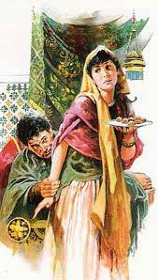
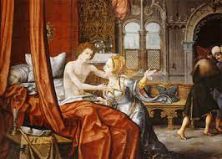
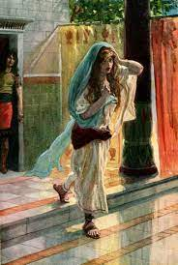
Tamar

Slide 26
Power of Personhood
Humans have a voice
  “To be created in the image of God is to have a self, to have a voice and creative expression. Abuse of power silences that self and the words, feelings, thoughts, and choices of the victim. Their desires are disregarded and irrelevant. Abuse of any kind is always damaging to the image of God in humans. The self is shattered, fractured, and silenced and cannot speak who it is into the world” (Langberg, 2020, p. 7).
To be human is to be in relationship
  Abusive power violates and shatters interpersonal relationships
  Abusive power distorts IOG
To be human is to have power and to shape the world
  ”The Creator called us to rule and subdue. Those are power words. Go have impact; go make things grow; go change things. Abuse quashes and removes power. A victim feels useless, powerless, and ineffective, and the loss of dignity and purpose is profound” (Langberg, 2020, p. 8).

Slide 27
DSM-5 Diagnostic Criteria for PTSD
Criteria A – Defining Trauma
The following criteria apply to adults, adolescents, and children older than 6 years. For children 6 years and younger, see the DSM-5 section titled “Posttraumatic Stress Disorder for Children 6 Years and Younger” (APA, 2013a).
Exposure to actual or threatened death, serious injury, or sexual violence in one (or more) of the following ways:
  Directly experiencing the traumatic event(s).
  Witnessing, in person, the event(s) as it occurred to others.
  Learning that the traumatic event(s) occurred to a close family member or close friend. In cases of actual or threatened death of a family member or friend, the event(s) must have been violent or accidental.
  Experiencing repeated or extreme exposure to aversive details of the traumatic event(s) (e.g., first responders collecting human remains; police officers repeatedly exposed to details of child abuse). Note: Criterion A4 does not apply to exposure through electronic media, television, movies, or pictures, unless this exposure is work related.

Slide 28
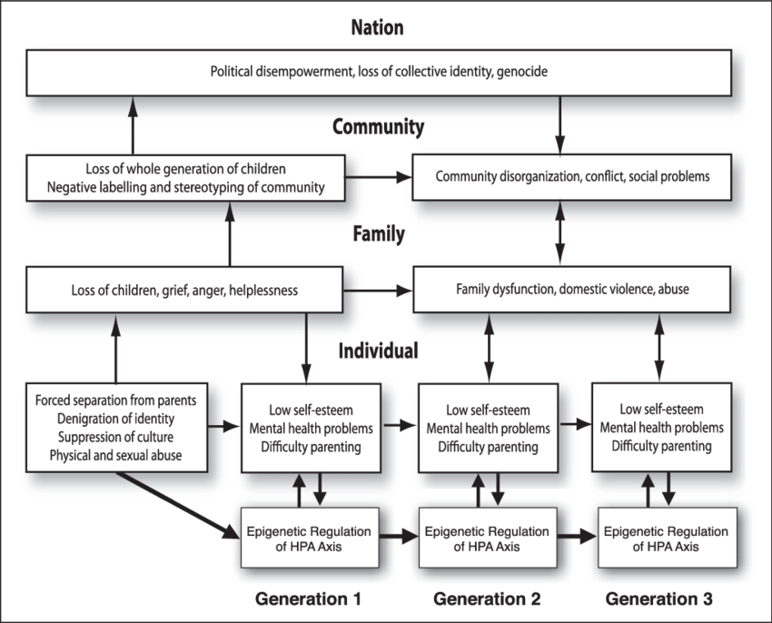
Generational impact of trauma

Slide 29

Trauma Theory—Spiral Metaphor
Stage 1: Safety and Stability
Stage 2: Remembrance and Mourning
Stage 3: Reconnection and Integration
Notes:
3 Es: Events, Experience, Effects (what did it lead to)

Slide 30
Safety and stability: STARTING ASSUMPTIONS
  Symptoms are stories
  It’s WHAT HAPPEN TO YOU? Not What is wrong with you?
  Trauma lives in our bodies
  The slower you go the faster you get there (to healing)
    3 R’s: Regulate, Relate, Reason (B. Perry)
    Dosing
  You can only take someone as far as you have gone in your own journey
Notes:
TST
Assumption #1: Trauma is fundamentally a bodily experience
Directly
Body retains the somatic memory of traumatic stress either directly in tissue cells or indirectly through the body’s natural changes in hormones (adrenaline and cortisol) that accompany fight or flight or dissociative escape responses

Slide 31
Stage 1: Safety and Stability
Establishing relational safety—Starting point is often mistrust not trust (all we need is a mustard seed)
Establishing bodily safety
Establishing safe environments
Using the right language
Building a support system (physically, mentally, relationally, spiritually and socially)
Regulation, regulation, regulation – Building capacity is key!

Slide 32
The importance of language
A shared language is key
A shared understanding of the path toward healing
The language we use to describe our experiences can exaggerate, minimize, or accurately reflect the significance and impact of what occurs
  Go back to slide 2, what language was used around the traumas? How did the person, system, culture respond? What was and/is the impact?
Strategies to minimize or deny harm:
  Trivialization—Experiences are minimized in comparison
  Particularization—One manifestation of harm is valued as more significant (his trauma is worse than mine)
  Spiritualization—Traumatic suffering is classified as a burden to bear akin to Jesus’s suffering on the cross
  Universalization—All people experience suffering
      ~ Daly, Mary (1973).
Notes:
How we choose to speak about and understand what occurs is influenced by what society can or will tolerate.

Slide 33
Remembrance and Mourning:
Starting Assumptions
We are meaning making beings—telling a story is about reworking our core narratives.
Unfinished or interrupted cycles of completion cause repetition compulsion cycles.
The bulk of the story that needs to be told lives in our body and is reworked and released by shuttle shifts not big aberrative exposure therapies.
The goal of this stage is integration and punctuation.
Rituals and an emphasis on a growth mindset are key.
Ambiguous loss isn’t about closure its about mastery.

Slide 34
Reconnection and Integration:
Starting Assumptions
We are built with purpose
Healing requires connection and community
Connecting the personal narrative to a bigger narrative
Mission finding – Tarana Burke #Metoo Movement
Real life is different than scaffolded environments—be patient and learn how to tolerate ambiguity

Slide 35
Trauma Sensitive Theology
Trauma Sensitive Theology--Interview with Jennifer Baldwin

Slide 36
Trauma Informed Faith Community
Safety
Trustworthiness and transparency
Mutual support
Collaboration
Empowerment, voice, and choice
Cultural, historical, self-identity

Slide 37
Class 2
Power
Complex PTSD
Developmental trauma
The Hero’s Journey

Slide 38
The issue of power
Diana Langberg, Ph.D. - Suffering and the Heart of God
Diana Langberg Interview

Slide 39
Types of Power
Verbal power
Emotional power
Physical power
Authoritarian
Absence
Economic power
Spiritual power
Cultural power
Notes:
Verbal power:
Using words as a weapon
Silence
Emotional power:
Emotions can be used to comfort or control

Slide 40
Complex Post-Traumatic Stress Disorder
A history of subjection to totalitarian control over a prolonged period (months to years). Examples include hostages, prisoners of war, concentration-camp survivors, and survivors of some religious cults. Examples also include those subjected to domestic battering, childhood physical or sexual abuse, and organized sexual exploitation.
Parental contempt
  “Contempt is a toxic cocktail of verbal and emotional abuse, a deadly amalgam of denigration, rage, and disgust. Rage creates fear, and disgust creates shame in the child in a way that soon teaches her to refrain from crying out, from ever asking for attention” (Walker, 2014, p. 10).

Slide 41
Complex Post-Traumatic Stress Disorder
Alterations in affect regulation, including
  Persistent dysphoria
  Chronic suicidal preoccupation
  Self-injury
  Explosive or extremely inhibited anger (may alternate)
  Compulsive or extremely inhibited sexuality (may alternate)

Slide 42
Complex Post-Traumatic Stress Disorder
Alterations in consciousness, including
  Amnesia or hyper-amnesia for traumatic events
  Transient dissociative episodes
  Depersonalization/derealization
  Reliving experiences, either in the form of intrusive PTSD symptoms or in the form of ruminative preoccupation.
  Sense of complete difference from others (may include sense of specialness, utter aloneness, belief no other person can understand, or nonhuman identity)

Slide 43
Complex Post-Traumatic Stress Disorder
Alterations in self-perception, including
  Sense of helplessness or paralysis of initiative
  Shame, guilt, and self-blame
  Sense of defilement or stigma

Slide 44
Complex Post-Traumatic Stress Disorder
Alterations in perception of perpetrator, including
  Preoccupation with relationship with perpetrator (includes preoccupation with revenge).
  Acceptance of belief system or rationalizations of perpetrator

Slide 45
Complex Post-Traumatic Stress Disorder
Alterations in relations with others, including
  Isolation and withdrawal
  Disruption in intimate relationships
  Repeated search for rescuer ( may alternate with isolation and withdrawal)
  Persistent distrust
  Repeated failures of self-protection

Slide 46
Complex Post-Traumatic Stress Disorder
Alterations in systems of meaning
  Loss of sustaining faith
  Sense of hopelessness and despair

Slide 47
Alterations
How feelings are managed
Memory and the ability to be present
Relationship
Concept of self
Concept of perpetrator
Systems of meaning

Slide 48
Developmental Trauma Disorder
A. Exposure
Multiple or chronic exposure to one or more forms of developmentally adverse interpersonal trauma (e.g. abandonment, betrayal, physical assaults, sexual as- saults, threats to bodily integrity, coercive practices, emotional abuse, witnessing violence and death).
Subjective experience (e.g. rage, betrayal, fear, resignation, defeat, shame).

Slide 49
Developmental Trauma Disorder (2)
B. Triggered pattern of repeated dysregulation in response to trauma cues
Dysregulation (high or low) in presence of cues. Changes persist and do not return to baseline; not reduced in intensity by conscious awareness.
  Affective
  Somatic (e.g. physiological, motoric, medical)
  Behavioral (e.g. re-enactment, cutting)
  Cognitive (e.g. thinking that it is happening again, confusion, dissociation,
  depersonalization).
  Relational (e.g. clinging, oppositional, distrustful, compliant).
  Self-attribution (e.g. self-hate, blame).

Slide 50
Developmental Trauma Disorder (3)
C. Persistently Altered Attributions and Expectancies
• Negative self-attribution.
• Distrust of protective caretaker.
• Loss of expectancy of protection by others.
• Loss of trust in social agencies to protect.
• Lack of recourse to social justice/retribution.
• Inevitability of future victimization.

Slide 51
Developmental Trauma Disorder (4)
D. Functional Impairment
• Educational
• Familial
• Peer
• Legal
• Vocational

Slide 52
Attachment
Capacity vs. Will
I am…
Other people are…
God is…
The World is…
Therefore I will…

Slide 53
Biology
Stress tolerance
Sensitization
  Bruce Perry, MD
Cognitive functions such as language development and abstract reasoning
Executive functioning skills
Increased risk of sensory-motor dysfunction
Increased risk of illness

Slide 54
Impact of Stress Diagram
Stress
Unpredictable, Extreme, Prolonged
SENSITIZATION (VULNERABILITY)
Predictable, Moderate, Controllable
Tolerance (Resilience)

Slide 55
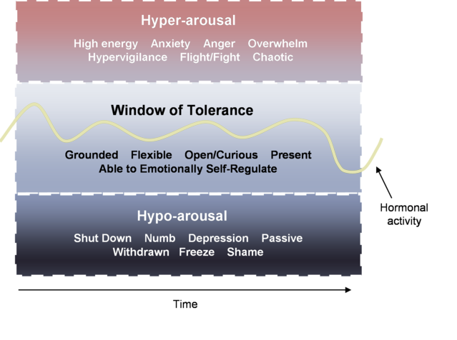
Affect
Inhibits child’s ability to self-soothe, tolerate stress or change
Difficulties identifying feelings and internal states

Slide 56
Dissociation
Adaptation
Bruce Perry MD, Ph.D. -- Dissociation and developmental trauma

Slide 57
Behavioral Control
The disruption in the brain and nervous system lead to:
  Inhibited impulse control
  Aggression
  Dysfunctional self-soothing patterns
  Disrupted sleep

Slide 58
NERVOUS SYSTEM: Co-regulation
Is it safe to connect?
The autonomic nervous system SENDS and SEARCHES FOR cues of safety or danger.
Two drives: SURVIVAL OR CONNECTION
The autonomic nervous system is both shaped and regulated through interactions with others.
The cues are sent from one system to another either
  CO-REGULATE AND INVITE NEW POSSIBILITIES OR
  INCREASE REACTIVITY AND REINFORCE HABITUAL SURVIVAL PATTERNS.

Slide 59
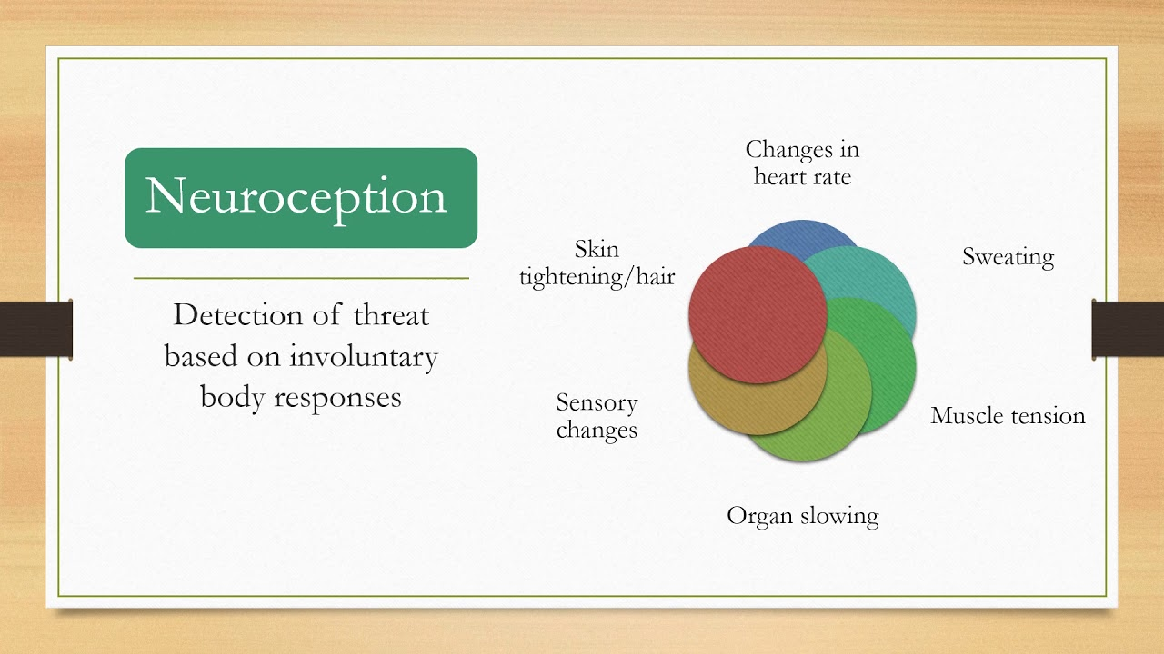
The Nervous System: NEUROCEPTION
Detection without awareness
The way which we take information in without involving our thinking brain.
Neuroception responds to cues of safety and danger inside the body, outside in the environment, and between people.
IN THIS MOMENT AM I SAFE OR IN DANGER?
Notes:
This is the antenna – monitoring for danger

Slide 60
Neuroception (Deb Dana)
NEUROCEPTIVE MATCH
  The autonomic nervous system moves into a state that brings energy needed to manage he situation effectively
NEUROCEPTIVE MISMATCH
  Inability to calm defense system in safe environments lead to a habitual hypervigilant alarm state.
  Inability to activate defense system in a risk environment leads to an inadequate response—either dulled and unaware or high risk taking

Slide 61
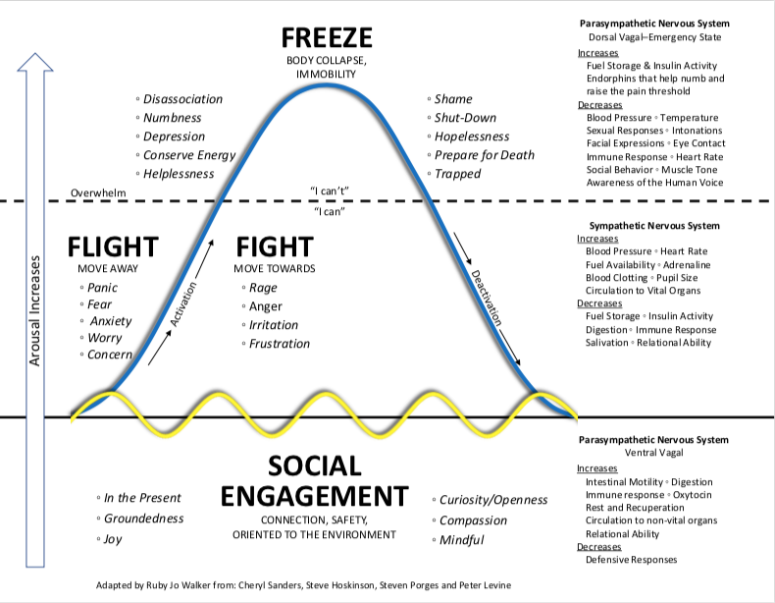
The Nervous System
Notes:
Based on cues of safety and danger

Slide 62
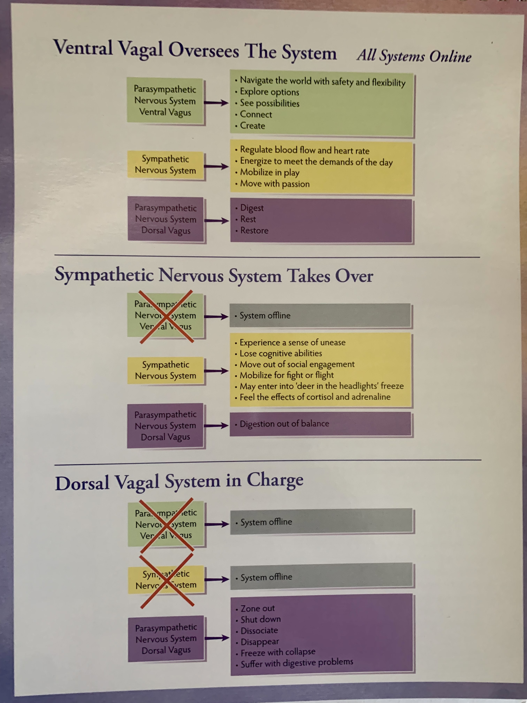

Slide 63
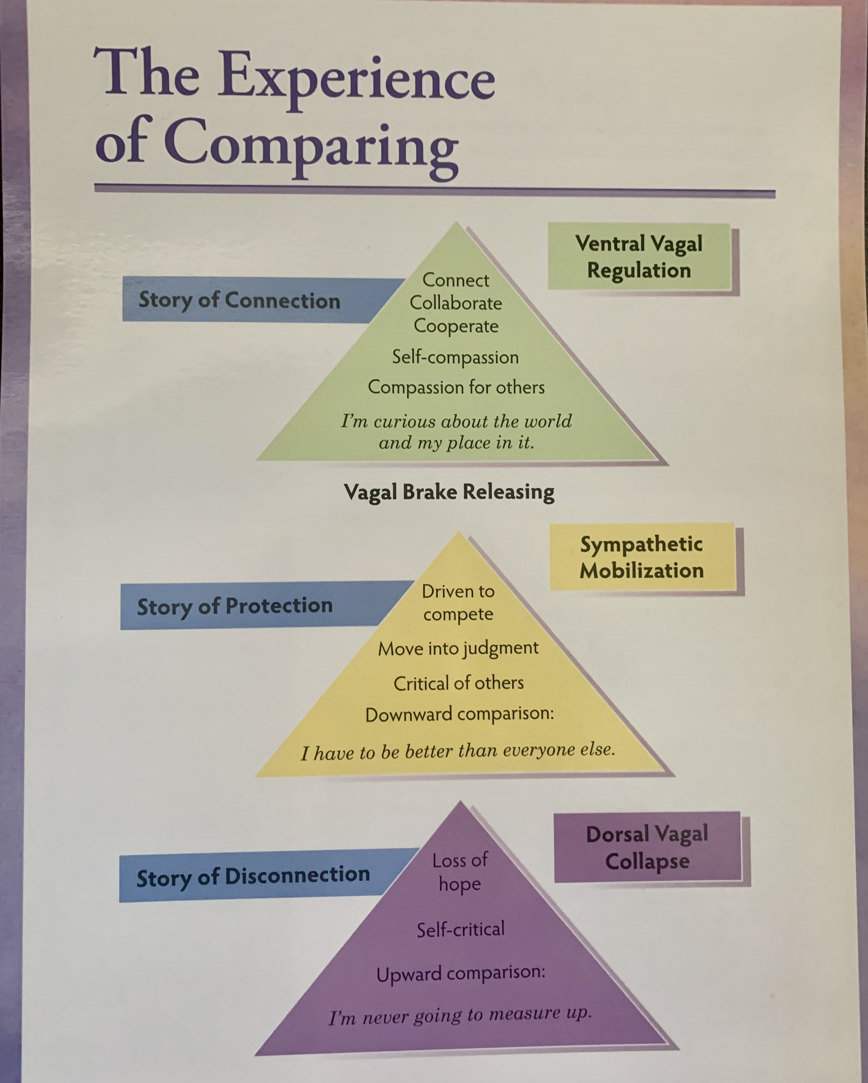

Slide 64
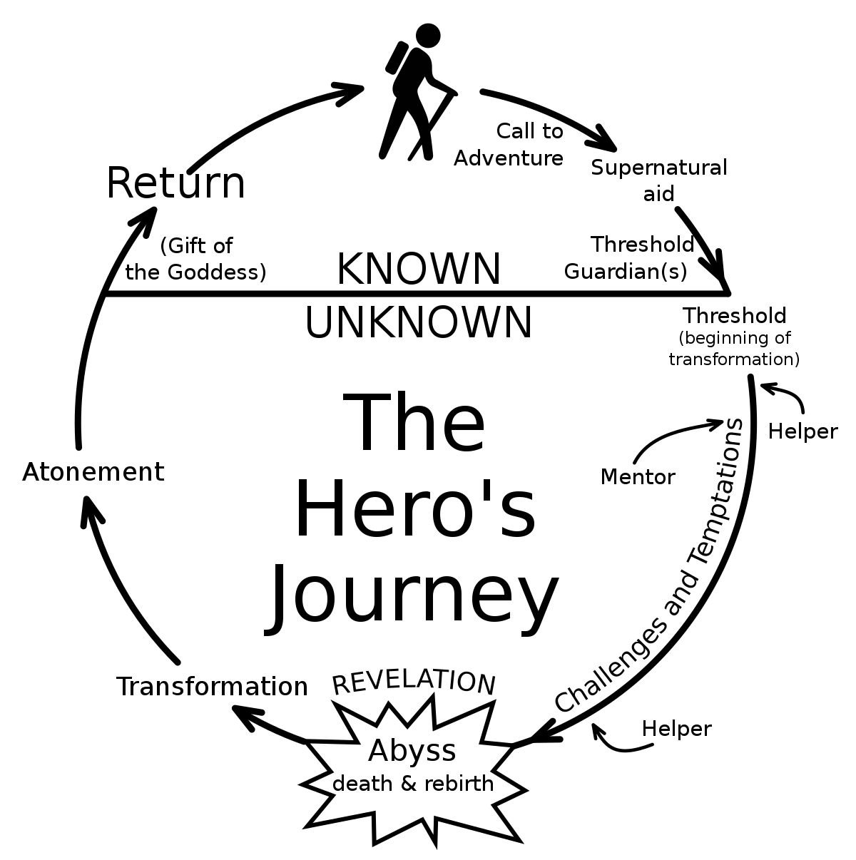
The Hero’s journey

Slide 65
Hero or Heroine
First deed: Fulfillment of a tangible task that seems impossible.
Second deed: Involves a journey along which the hero or heroine uncovers hidden mystical knowledge about human existence, often returning with a sacred message.
There is always a dragon on the journey.
Read page 1 paragraph 2

Slide 66

Finding Joe

Slide 67
TRAUMA-SENSITIVE THEOLOGY (TST)
Baldwin, J. ( 2018). Trauma Sensitive Theology.
  Assumptions:
    Commitment to the understanding that trauma is fundamentally a bodily experience
    Commitment to accept the trauma narrative
    Commitment to the natural given-ness of human multiplicity
    Commitment to a robust faith in human resiliency

Slide 68
Collective Trauma
Collective Trauma--Thomas Hubl

Slide 69
Trauma as a Collective Experience
Thomas Hubl - Trauma as a Collective Experience

Slide 70
The Adverse Childhood Experience study
Nadine Burke Harris / TEDMED 2014

Slide 71
Health and Childhood Trauma
Gabor Mate: The uncomfortable truth about illnesses and childhood trauma

Slide 72
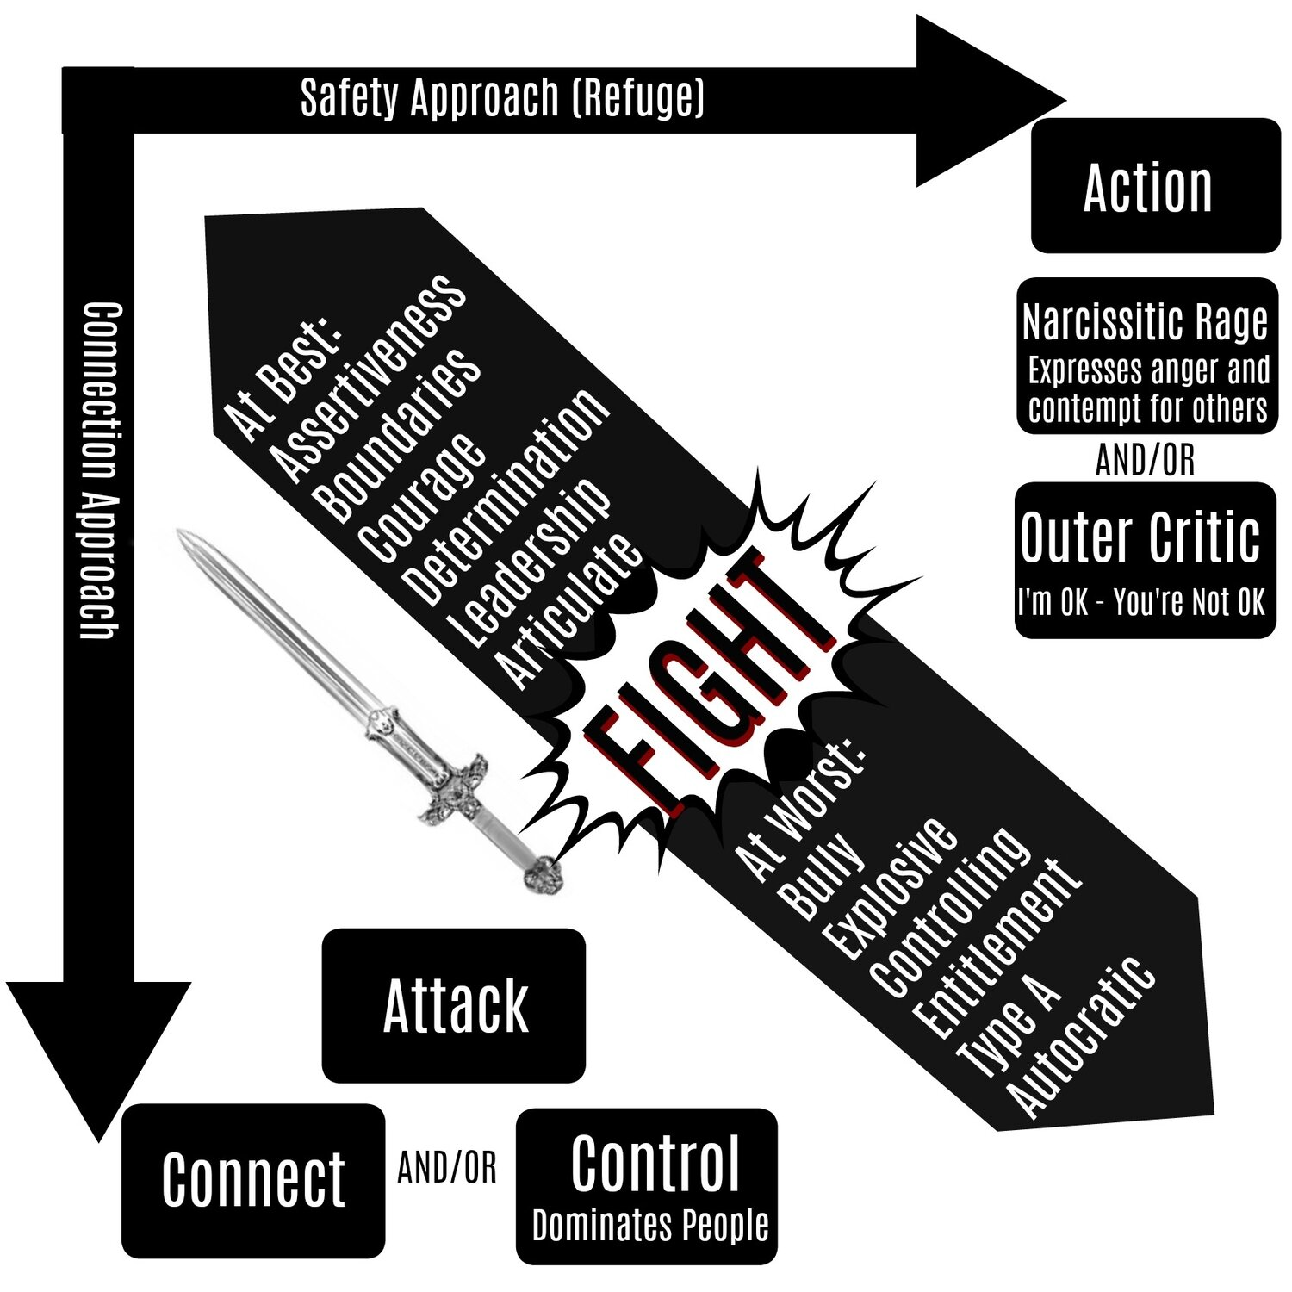

Slide 73
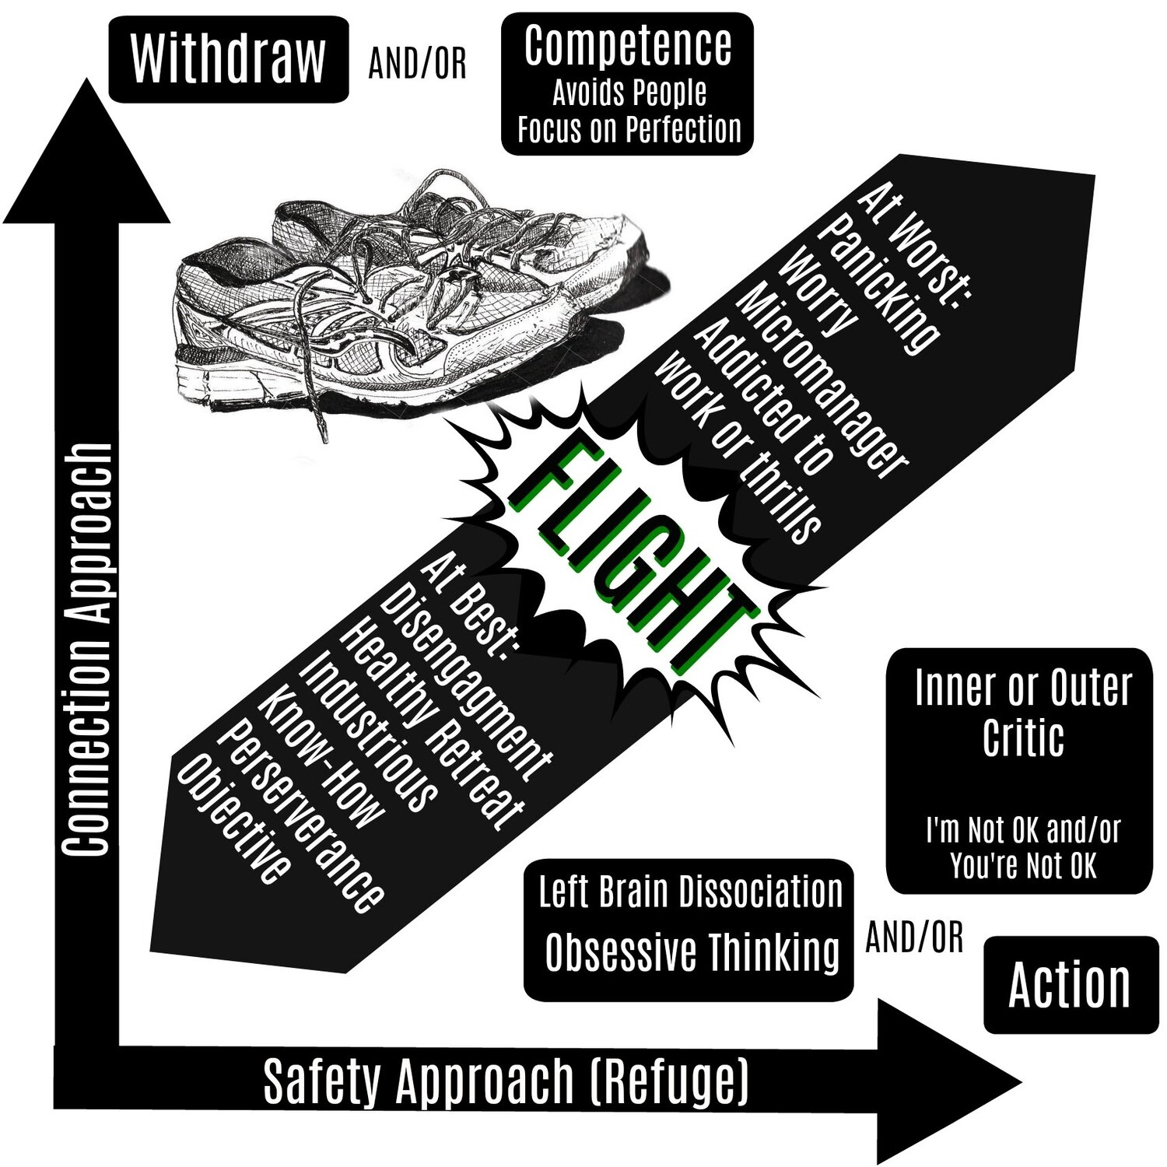

Slide 74
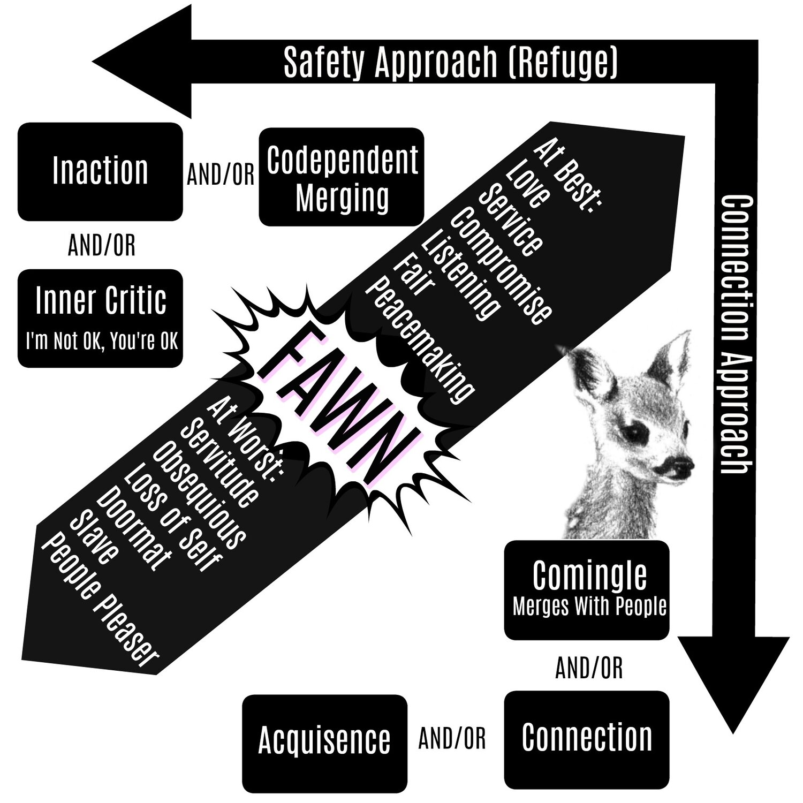

Slide 75
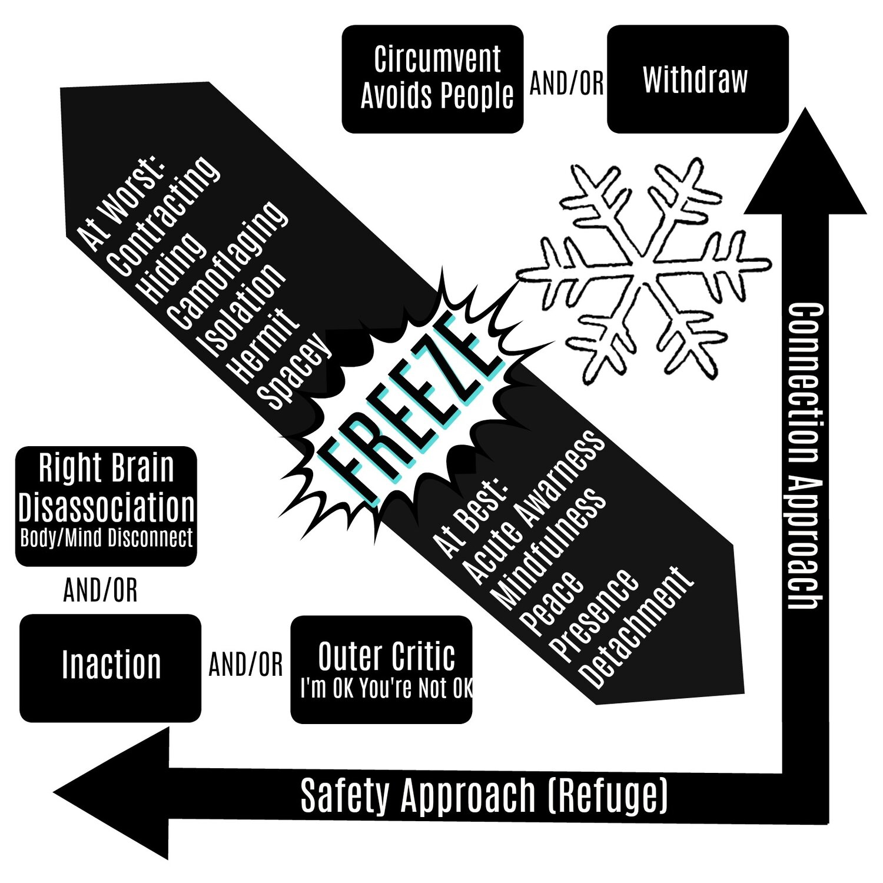

Slide 76
Class 3
Review: Body (Somatic) → Dynamic (Attachment) → Cognitive (Reason)
  Bruce Perry – Regulate → Relate → Reason
The Significance of the template of The Hero’s Journey paradigm
Stages of Change Model
Walk through Hubl’s chapter 3
Attachment
Attachment and Spirituality

Slide 77
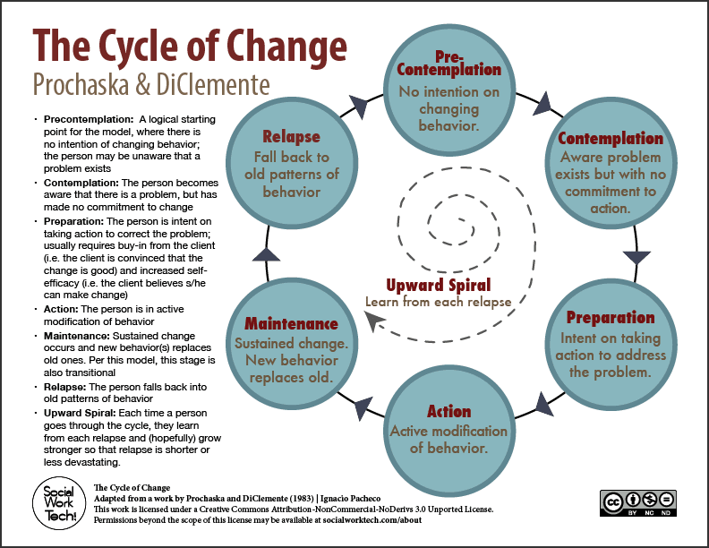

Slide 78
Chapter 3: The Inner Science of Trauma
“We are both I and We, body and society, psyche and culture” (p. 31).

Slide 79
Attachment
Is an inborn system in the brain that evolves in ways that influence and organize motivational, emotional, and memory processes with respect to significant caregiving figures (Siegel, 1999, p. 67)
It modulates stress response.
What begins as biologically driven interactions may register psychologically as mental representations that continue lifelong to shape behavior and subjective experience whether or not the original attachment figures are physically present (Wallin, 2007, p. 24)

Slide 80
Key Principles of Attachment
Proximity Seeking
  The biological function of the attachment system, as described by Bowlby (1969/1982), is the maintenance of proximity between an infant and an expectably protective attachment figure.
Safe Haven
  Three types of situations that elicit attachment behavior:
    1. Frightening or alarming environmental events
    2. Illness, injury, or fatigue
    3. Separation or threat of separation from attachment figures

Slide 81
Key Principals (2)
Secure Base
  The attachment figure provides a secure base for exploration and, relatedly, a sense of felt security

Slide 82
Inner connection with others:
Internal Working Model (Schema)
I am
Other people are
God is
The world is
Therefore I will

Slide 83
Attachment
(Richard Rohr, Falling Upward)
The archetypal idea of “home” points in two directions at once. It points backwards toward an original hint and taste for union, starting in the body of our mother. We all came from some kind of home, even a bad one, that always plants the foundational seed of a possible and ideal paradise. And it points forward, urging us toward the realization that this hint and taste of union might actually be true. It guides us like an inner compass or homing device…Most of us cannot let go of this implanted promise. Some would call this homing device their soul, and some would call it the indwelling Holy Spirit, and some might just call it nostalgia or daydream. All I know is that it will not be ignored.

Slide 84

This is the loop—the “Enso”, the re-enactment

Slide 85
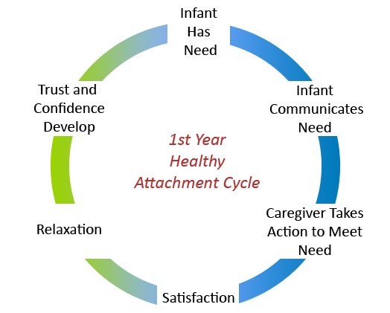
The Cycle of Healthy Attachment—First Year

Slide 86
Attachment IWM (1)
It is relatively easy for me to become emotionally close to others. I am comfortable depending on others and having others depend on me. I don't worry about being alone or having others not accept me.

Slide 87
Attachment IWM (2)
I am comfortable without close emotional relationships. It is very important to me to feel independent and self-sufficient, and I prefer not to depend on others or have others depend on me.

Slide 88
Attachment IWM (3)
I want to be completely emotionally intimate with others, but I often find that others are reluctant to get as close as I would like. I am uncomfortable being without close relationships, but I sometimes worry that others don't value me as much as I value them.

Slide 89
Attachment IWM (4)
I am somewhat uncomfortable getting close to others. I want emotionally close relationships, but I find it difficult to trust others completely, or to depend on them. I sometimes worry that I will be hurt if I allow myself to become too close to others.

Slide 90
Avoidant Attachment Style (2)
Positive view of self, negative view of others
Disembodied
Skills to manage affect and social engagement were impacted in the attachment relationship
  Fear of intimacy
    Struggles with emotional connection
    Struggles with disclosure of private thoughts and feelings
    Struggles with nonsexual touch
Relationship rules:
  Other people are not reliable, dependable, or trustworthy when it comes to my needs
  I must rely on myself alone in order to meet my needs
Notes:
Enormous difficulty trusting others
“Compulsive self-reliance”
Reluctant to feel emotions that may spur them to connect deeply to others
Appear “resistant”
Acknowledging the need for help may feel like an invitation to rejection or a humiliating admission of insufficiency
Needing help and not finding it is always a risk, but getting it may represent an even greater risk

Slide 91
Avoidant Attachment Style
Hard expressed grief
3 shades of avoidance:
  The narcissist or inflated false self
  The exiled or disconnected self
  The compulsive perfectionist

Slide 92
Anxious (Preoccupied) Attachment Style (3)
Vulnerable towards hyperarousal
Tend to cling in relationships due to fear and anxiety but are not able to be soothed for the same reasons
Terrified and very sensitive to abandonment/rejection
Vulnerable to be highly dependent
Clingy (mergers) and protracted grief
3 shades of dependency:
  The anxious dependent: Feel vulnerable all the time
  The melodramatic dependent
  The angry dependent

Slide 93
Anxious (Preoccupied) Attachment Style
Polar opposite of the dismissive style:
  Lively and vivid but also overwhelmed by their feelings and absorbed in avoiding distance from others
  Filled with self-doubt and fearful of being too independent
  Trouble relying on self

Slide 94
Fearful/Avoidant Attachment Style (4)
Highly dissociative
Rapid shifts from hypoarousal and hyperarousal
Panic, self-harming behaviors, depression
Never developed a consistent strategy to connect in relationships
Disinhibited grief due to ruptured self-capacities

Slide 95
Fearful/Avoidant Attachment Style
Key is the lack of resolution with regards to unresolved childhood experiences
More cumulative and relational trauma
High levels of dissociation and other primitive defenses

Slide 96
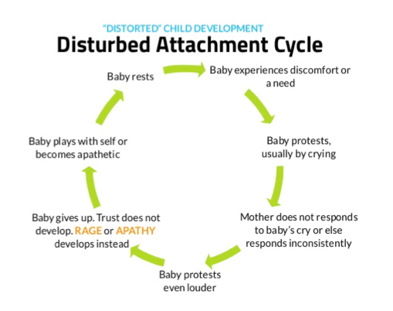
The Cycle of Disturbed Attachment—First Year

Slide 97
Surrogate Objects of Attachment
Transitional objects

Slide 98
Attachment-Religion Connection
Relationality
  The word “religion” stems from the Latin “religate” meaning “being bound”.
Centrality of love
  The process of sudden religious conversion has frequently been likened to falling in love (James, 1902, Thoules, 1923, Ullman, 1989, and many more)
Representations of God
  This was the starting point for the attachment-religion connection
  IOG as a kind of parent
  What kind of attachment imagery do you see in the Psalms?
Notes:
This relationship connotation corresponds with how people evaluate their own faith. For example, when asked to make a forced choice about what is most central to their own view of “faith”—a set of beliefs, membership in a church or synagogue, finding meaning in life, or a relationship with God-–a slight majority (51%) of an American Gallup sample chose a relationship with God (p.46, Granqvist, 2021)

Slide 99
Seeking and Maintaining Proximity to God
The biological function of the attachment system, as described by Bowlby (1969/1982), is the maintenance of proximity between an infant and an expectably protective attachment figure.
Places of worship, various idols and symbols (e.g. Torah scroll in Judaism, the cross in Christianity, the star and crescent in Islam) to remind the believer of God’s presence.
Prayer
  Two related to proximity maintenance: Contemplative and Meditational
  Safe haven function: Petitionary prayer—help seeking, a requesting form of prayer
  Social referencing and secure base behaviors—
    Upward prayer – Human-divine connection
    Outward prayer – Human-human connection
    Inward prayer – Self-connection
Notes:
To achieve this objective – variety of behaviors such as crying, raising arms, clinging, crawling, or walking to follow. Older children may accomplish “felt security” they have mental representations of CGs and symbols/TO to connect to that security.
Petitionary prayer believed to be the oldest

Slide 100
Separation and Loss Responses
Separation from an attachment figure—even the threat of separation—causes ANXIETY in the attached person at the experiential level and PROTEST at the behavioral level.
Permanent loss of an attachment figure cause grief and a mourning process is initiated
  Protest → Despair → Detachment → Reorganization

Slide 101
God as safe haven
Safe Haven ala Bowlby (1969/1982)
Three types of situations that elicit attachment behavior:
  1. Frightening or alarming environmental events
  2. Illness, injury, or fatigue
  3. Separation or threat of separation from attachment figures
According to research people are most likely to turn to God in times of trouble and crisis (Granqvist, 2021)
Three general classes that trigger this:
  1. Illness, disability, and negative life events
  2. The anticipated or actual death of a friend or relative
  3. Adverse life experiences

Slide 102
Noteworthy finding
Under stress, loss of relationship (through death or divorce), or nature disasters people are more likely to turn to faith and prayer (attachment behavior) rather than to church (a proxy for social support).

Slide 103
God as secure base
The attachment figure provides a secure base for exploration and, relatedly, a sense of felt security.

Slide 104
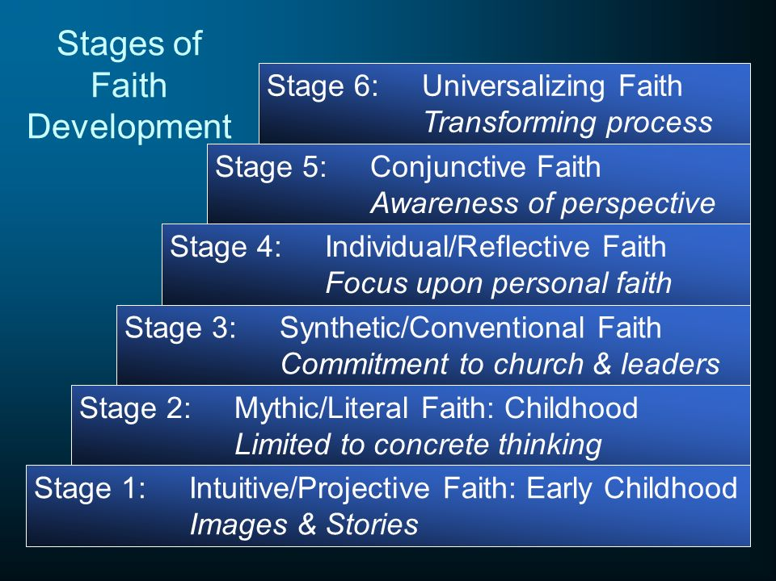

Slide 105
Class 4:
Review Attachment Model
Hero’s Journey Discussion
Definition of Crisis
Theory overview
ABC Model for Crisis

Slide 106
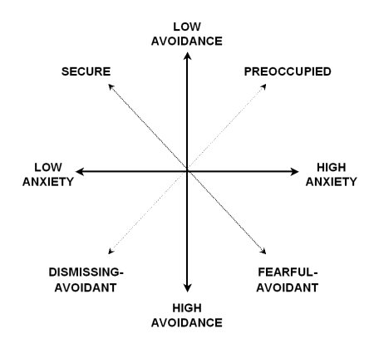
Dimensions of Attachment

Slide 107

“If you don’t like something, change it. If you can’t change it, change your attitude.”
The Hero's Journey--Maya Angelou
You may write me down in history with your bitter, twisted lines. You may trod me in the very dirt, but still, like dust, I'll rise.

Slide 108
Questions
What some people may react to as traumatic other cultures may relate to as life?
If trauma is defined as an event that causes a sense a fear, helpless, demoralization, and disconnection for one’s self—body, emotions, and spirit; relationships--interpersonal and with God; and community does race and culture change the IMPACT?
What variables make the impact variable (dose/response relationship)?
How do we—the pastors/counselors help create ”Enso opportunities”?
What are the conditions that are necessary to create the “space” to move through the process?

Slide 109
Definition of crisis
”An obstacle that is, for the a time, insurmountable by the use of customary methods of problem solving” (p.2).
“A period of disorganization ensures, a period of upset, during which many abortive attempts at solution are made” (p.2).
“An upset in the steady state for the individual” (p.2).

Slide 110
Crisis as both opportunity and danger
Opportunity
  Intervention = > level of functioning
  Increased level of function = growth, insight, coping skills, increased capacity and will
Danger
  No intervention = < level of functioning
  No intervention = > need for stopgap measures such as D/A, self-harm, shutdown
  No intervention → > self-harming behaviors → > psychiatric distress → less connection to support

Slide 111
Contributions from other theoretical modalities
Psychoanalytical Theory
  Disequilibrium when other coping strategies have failed and energy is depleted.
  Addresses developmental trauma.
Existential Theory
  Identifies anxiety as a normal part of existence that can serve as a catalyst to growth.
  Acceptance of personal responsibility.
  Choice
Humanistic Theory
  Person-centered
  Reflective and empathetic techniques
  Centered on the benefits of therapeutic relationships.
Cognitive Behavioral Theories
  Focused on the person’s cognitive view of the problem and then restructuring and reframing maladaptive cognitions.
  Formula—page 18
Critical Incident Stress Debriefing
  Involves a seven-phase structured group discussion
  Within 1-14 days post crisis
  Designed to mitigate acute symptoms
  Assess the need for follow-up
  Provide a sense of post-crisis psychological closure

Slide 112
Existentialism
European Existentialism
Black Existentialism
Martin Luther King Jr.
Victor Frankl--Existential Theory
Victor Frankl—Quotes
Nietsche—Quotes
Carl Rogers and Paul Tillich
Notes:
On the Boundary – Paul Tillich
Son of a Lutheran minister
Rejecting his father’s conservative theology
Dialectic between the ideal and the real (sounds similar to Parker Palmer’s notion of “Practical Theology”)
Concerned with the “Unconditioned” – Come before, behind, or beyond the condition but to somehow to be encountered within the condition. That that transcends the conditioned reality.
When moving into the working class environment it changed him—framed what he saw as “Religious Socialism”
Left to go to WW1 as an army chaplain

Slide 113

Break

Slide 114
Ethics of Being in a Helping Relationship
Ethical Issues
  Autonomy—Freedom of choice
  Nonmalfeasance—Do NO harm!
  Beneficence—Contributing to the welfare of the client and attempting to benefit the client
  Justice—Providing equal treatment for all clients
  Fidelity—Honoring commitments and guarding trust
Self-Awareness and Self-Monitoring
Dual Relationships
Confidentiality

Slide 115
Reporting Abuse
Elder Abuse
Physical abuse, fiduciary abuse, neglect, or abandonment
Child Abuse
  Tarasoff
  Informed consent
Competence
Client’s Rights

Slide 116
A: Developing Rapport
Basic Attending Skills
  Eye Contact
  Body Language
  Vocal Style
  Verbal following
Questioning (pp. 41-44)
  Open ended (exploratory)
  Closed ended (ascertain facts)

Slide 117
A: Developing Rapport
Clarifying
Paraphrasing
Reflection of Feelings
Summarization

Slide 118
B: Identifying the Problem
Identifying the Precipitating Event
Recognizing the Meaning or Perception of the Precipitating Event
Identifying Emotional Distress and Functioning Level
Making Ethical Checks
Substance Misuse/Abuse Issues (open-ended questions reduce defensiveness)
Therapeutic Interaction (most important part of the session)
  Validation Statements
  Educational Statements
  Empowering Statements
  Reframing Statements

Slide 119
C: Coping
Exploring the Client’s Own Attempts at Coping
Encouraging the Development of New Coping Behaviors
Presenting Alternative Coping Behaviors
Commitment and Follow-Up

Slide 120
ABC Model of Crisis Intervention
4 Parts:
1. A precipitating event occurs
2. A person has a perception of the event as threatening or damaging
3. This perception leads to emotional distress
4. The emotional distress leads to impairment in functioning due to failure of an individual’s usual coping methods

Slide 121
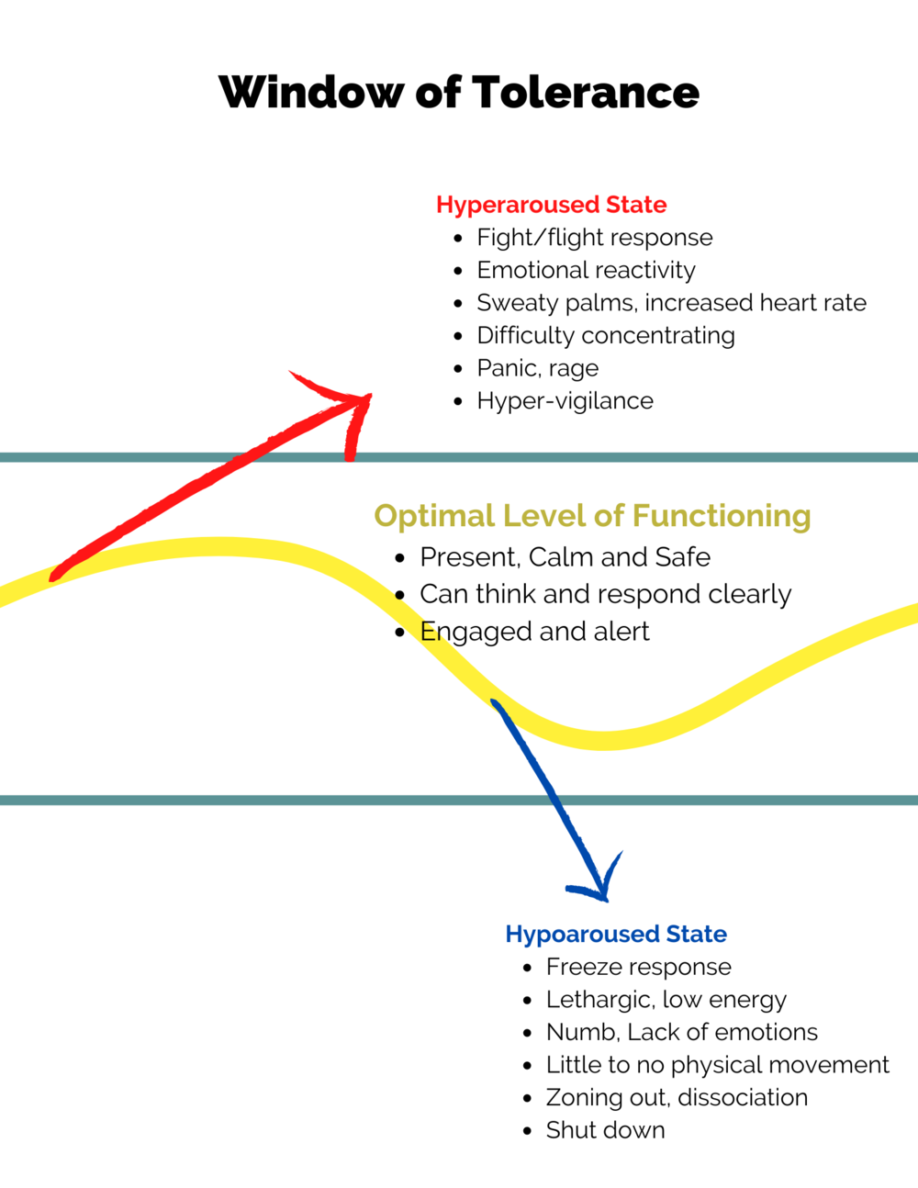

Slide 122

Class 5: Suicide

Slide 123
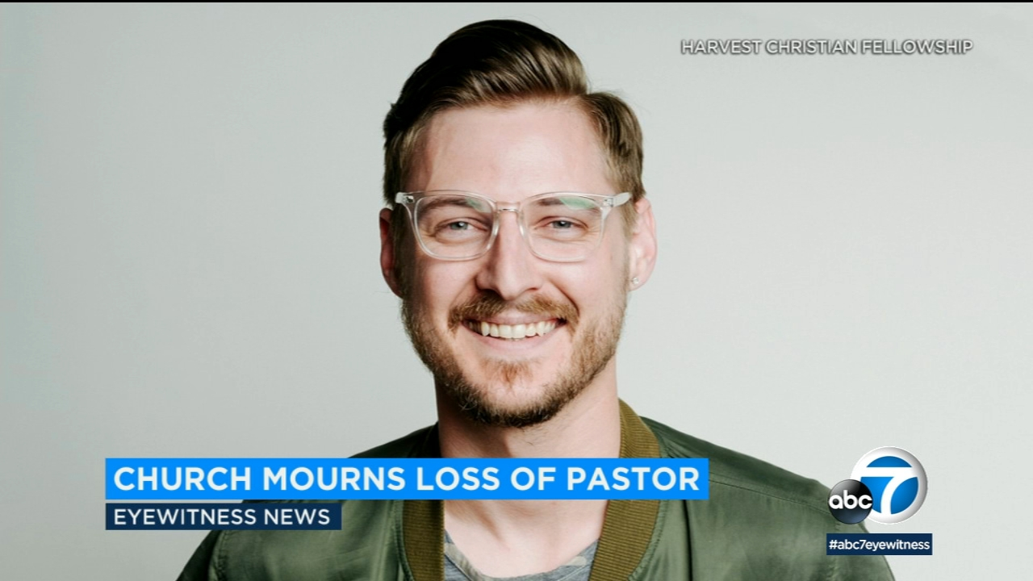

Slide 124
Myths about suicide
Real Christians don’t experience suicidal thoughts
Prayer is all a Christian needs—just pray harder
People who are suicidal are just trying to get attention
People who kill themselves are just being selfish
People who kill themselves are angry and vengeful
Depressed people should just “buck up”
People who are suicidal don’t tell anyone
Talking about suicide may give the person the idea to complete suicide
If someone wants to kill themselves there is nothing I can do
Most suicides occur over the holidays

Slide 125
Review of the Literature:
Religion and Suicide Risk
(Lawrence, MD, Mdiv, Oquendo, MD, & Stanley, PHD., 2016)
Results:
Religious affliliation DOES NOT protect against suicide ideation.
Religious affiliation DOES protect against suicide attempt, and the severity of suicide attempt.
  Appears more related to social support not a specific tenet of faith.
  Study (n=36,984) found that “suicidal acts” were LEAST common among those who attended services weekly, with greater odds among those who attended monthly, yearly, etc,
MUST consider culture-specific implications of affiliating with a particular religion—Some connect the person with community resources, while others could isolate the person.

Slide 126
Suicide in the Bible
What is the difference between Judas and Peter (Matthew 26:75) after their betrayal of Jesus?
Why did one kill himself and the other did not?
What do we think of Samson’s death (Judges 13-16)?
What about Saul (1 Samuel 31:1-4)?

Slide 127
Suicide Statistics (2019)
National Institute of Mental Health
The total adjusted suicide rate in US in 2019 was 13.9 per 100,000
Males were 3.7 times higher than females
  Among females, the suicide rate was highest for those aged 45-64
  Among males, the suicide rate was highest for those 75 and older.
Suicide was the 10th leading cause of death overall in the US, claiming over 47,500 people.
Suicide was the 2nd leading cause of death among individuals between the ages of 10 and 34.
Suicide was the 4th leading cause of death among individuals between the ages of 35-44.
There were nearly 2 and ½ times as many suicides in the US as there were homicides.

Slide 128
Suicide Statistics (2)
Firearms were the most common method used in suicide deaths in the US, accounting for OVER HALF (23,941).
Among females the most common method was a firearm (31.4%), poisoning (30%), and suffocation (29%).
Among males: firearms (55.6%), followed by suffocation (28.4%).
Race:
  Highest for American Indian, followed by White, Non-Hispanic males.
  Highest for American Indian, Non-Hispanic females and White, Non-Hispanic females.

Slide 129
Definitions
Suicidal Ideation – Thoughts about wanting to kill oneself
Means – The actual physical implement, pills, or action that a suicidal person uses to kill him or herself.
Plan – The blueprint for action
No-suicide contract – a written or verbal agreement between IP and Interventionist (effective with low and moderate risk people)
High-risk – Plan, means, intent, can’t be talked out of it (Hospitalization)
Moderate-risk – Ideation, depressed, still has some hope, may have a plan (Crisis)
Low-risk – Pondering (some ideation), no history of attempts, has social support (outpatient tx/education)

Slide 130
Symptoms and clues
Giving things away
Putting things in order
Writing a will
Withdrawing from usual activities
Being preoccupied with death
The recent death of a friend or relative
Feeling hopeless, helpless, or worthless

Slide 131
Symptoms and clues (2)
Increasing drug and alcohol use
Displaying psychotic behaviors
Giving verbal hints such as, “I am no use to anyone anymore.”
Showing agitated depression
Living alone and being isolated

Slide 132
SOME CIRCUMSTANCES THAT CONFER WITH SUICIDE (Mason, 2014)
Childhood sexual abuse
Intimate partner violence and conflict
Social isolation
Firearm ownership
Low SES
Economic recession
Chronic pain
Homelessness
Being a veteran
Sexual orientation
For adolescents: problems with parents

Slide 133
Suicide assessment (p.72-73)
Demographics
Ideation
Management of suicidal ideation
Current state of suicidality
Planning for subsequent attempt
Comorbidities
Family history
Biological markers
Protective factors
Diagnoses
Psychosocial environmental problems

Slide 134
Assessment
Suicide-Assessment-Form-Checklist
Suicide Contract (p.77)

Slide 135
Class 6
Review sermon outlines
Checking in as we are over the hump…how are we feeling? Doing?
Metaphor check in
Finish suicide conversation
Go through chapter 5: Developmental and cultural crises
Video: Reesma Menakem

Slide 136
Suicide and Theology
Sin, not a sin?
Moral or medical?
How do you manage this conversation?
Does the conversation help the suicidal person?

Slide 137
HOW CAN YOU HELP
Teaching a theology of life and death, including moral objections to suicide.
  Respect for life, Duty to others, ??
Teaching theodicy, or how to understand and manage suffering.
Directly engaging the issue of suicide—stigma free—when people become suicidal, attempted suicide, or die by suicide.
Teaching how to build a life worth living with meaningful purpose and belongingness.
Offering community where relationship skills are learned and practiced and where those who need support get it.
Partnering with others in preventing suicide.

Slide 138
Praxis (Robert McAfee Brown)
Praxis is that back and forth motion (RYTHMN) between action and reflection characteristic of liberation methods.
  It is set in motion by hearing stories through new ears and seeing concrete, particular events through the eyes of those who suffer (Townsend, 2006, p.61).
5 POINTS TO AN EFFECTIVE PRAXIS:
  Praxis avoids abstractions. It is related to specific situations of real people in everyday life.
  Action-reflection related to these specific situations is always about transforming the present. Truth is something done, not discovered.
  PRAXIS IS NOT ABOUT FINDING SOLUTIONS FOR PEOPLE. It is about empowering the oppressed to change their situation.
  It is the activity of a community engaged in a intentional cycle of action and reflection.
  It is a method of constructive theology that is never complete. It I always willing to corrected by truth emerging in action.

Slide 139
Praxis:
Mutual Transformation
Necessary Elements:
  Careful listening invites stories into the life of the community
  Those who suffer respond to the invitation
  The community makes its resources available for the process of action-reflection and empowerment of those who suffer.

Slide 140
CASE STUDY
Small group exercise--Introducing Suicide

Slide 141
HERMENEUTICAL CIRCULATION:
THE MOTION OF THE LIBERATION PRAXIS
EXPERIENCE OF PERSONAL AND FAMILY STORIES JARS OUR FRAME OF REFERENCE
OUR UNDERSTANDING IS INADEQUATE, OUR PERCEPTIONS EXPAND, AND WE REFLECT ON THE NEED FOR CHANGE
WE TURN TO OUR THEOLOGICAL SOURCES AND FAITH TRADITIONS WITH NEW QUESTIONS
IN CONVERSATION WE GAIN A NEW LEVEL OF AWARNESS AND FIND NEW OPTIONS FOR TRANSFORMATION
THE SCOPE OF ACTION WIDENS AS WE RETURN TO PEOPLE’S STORIES WITH TRANSFORMED MEANINGS AND ACTIONS

Slide 142

Developmental and Cultural crisis

Slide 143
Developmental vs. Localized Effects
Developmental Effects: Interfere with development tasks
  Attachment
  Behavioral and emotional self-regulation
  Development of the self
  Cognitive and academic functioning
  Peer relations
            SELF-CAPACITIES:
              FEELING MANAGEMENT
              SELF-WORTH
              RELATIONSHIP CAPACITIES
Localized Effects:
  Nightmares
  Posttraumatic stress reactions

Slide 144
Erik Erikson/John Wilson
Notes:
Look at p.98 chart

Slide 145
Fear of missing out – fomo
Herman (2016)
Strong’s Definition: A feeling of anxiety that an exciting or interesting event may currently be happening elsewhere
Exasperated by social media
Cognitions associated with FOMO: “I should be able to exhaust all the opportunities I want,” “Others are able to exhaust all they want,” “There are so many attractive opportunities.”
WHAT ARE THE CONSEQUENCES OF FOMO?
CAN YOU SEE OR FEEL THE EMOTIONAL DISTRESS CONNECTED TO FOMO?

Slide 146
SOCIAL MEDIA AND FOMO
Question of technology
THE QUARTER-LIFE CRISIS: a period of insecurity, doubt and disappointment surrounding your career, relationships and financial situation.
Common symptoms of a quarter-life crisis are often feelings of being "lost, scared, lonely or confused" about what steps to take in early adulthood.
Erikson’s stage: Intimacy vs. Isolation

Slide 147
Issues of Closeness
Enmeshment: Everyone in the family interferes and is overly involved in everyone’s else’s decisions, feelings, wishes, and behaviors. Struggle to separate.
  Symbiosis →
  Separation/Individuation →
  Differentiation →
  Practicing or Individuating →
  Reconnection/Rapprochement →
  Synergy/Mutual interconnection (Margaret Mahler—Object Constancy)
Disengagement: The rule in these families is not to get to close emotionally or socially.
  Distance
  Relationship is functional
  Independence is encouraged
  May create feeling of not being supported or loved

Slide 148
Evolutional Crisis
Marital Subsystem (First stage of a family)
Parental Subsystem
Sibling Subsystem
Grandparent Subsystem
Identify whether crisis is related to unhealthy boundaries such as, enmeshment, or disengagement

Slide 149
CRISIS RELATED TO CULTURE
Development of Cultural Humility
Etic vs. Emic Issues
Emic Issues of Latinos (p.104-105)
Emic Issues Related to African American Families (p. 106-107)
Emic Issues Related to Asian American Families (107-108)
Resmaa Menakem: Somatic Abolitionism

Slide 150

Grief

Slide 151
Class 7
Sermon questions
Review Chapter 6 – Grieve
Review Chapter 7 – PTSD
Work with articles
Discuss final assignment

Slide 152

Class 8

Slide 153
Class 9
Sermon Project Clean-up
Intimate Partner Violence
Sermons
System dynamics -- Incest

Slide 154
Trauma and Metaphor
Metaphors from articles:
Stage 1—
Stage 2—
Stage 3—

Slide 155
Intimate partner Violence
Domestic terrorism
No Visible Bruises by Rachel Louise Snyder
Between 2000-2006, 3200 American soldiers were killed in combat. During that same period, more than three times as many women died at the hands of their husbands and boyfriends (Rachel Louise Snyder 2019)
Gabby Petito
What are the dynamics that allowed this to happen?

Slide 156
Male Privilege
The Main Strategies of the Abuser

Slide 157
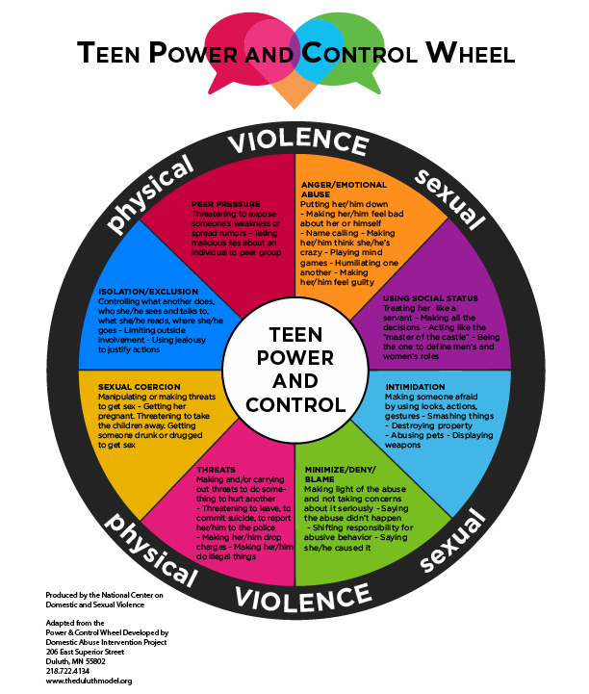

Slide 158
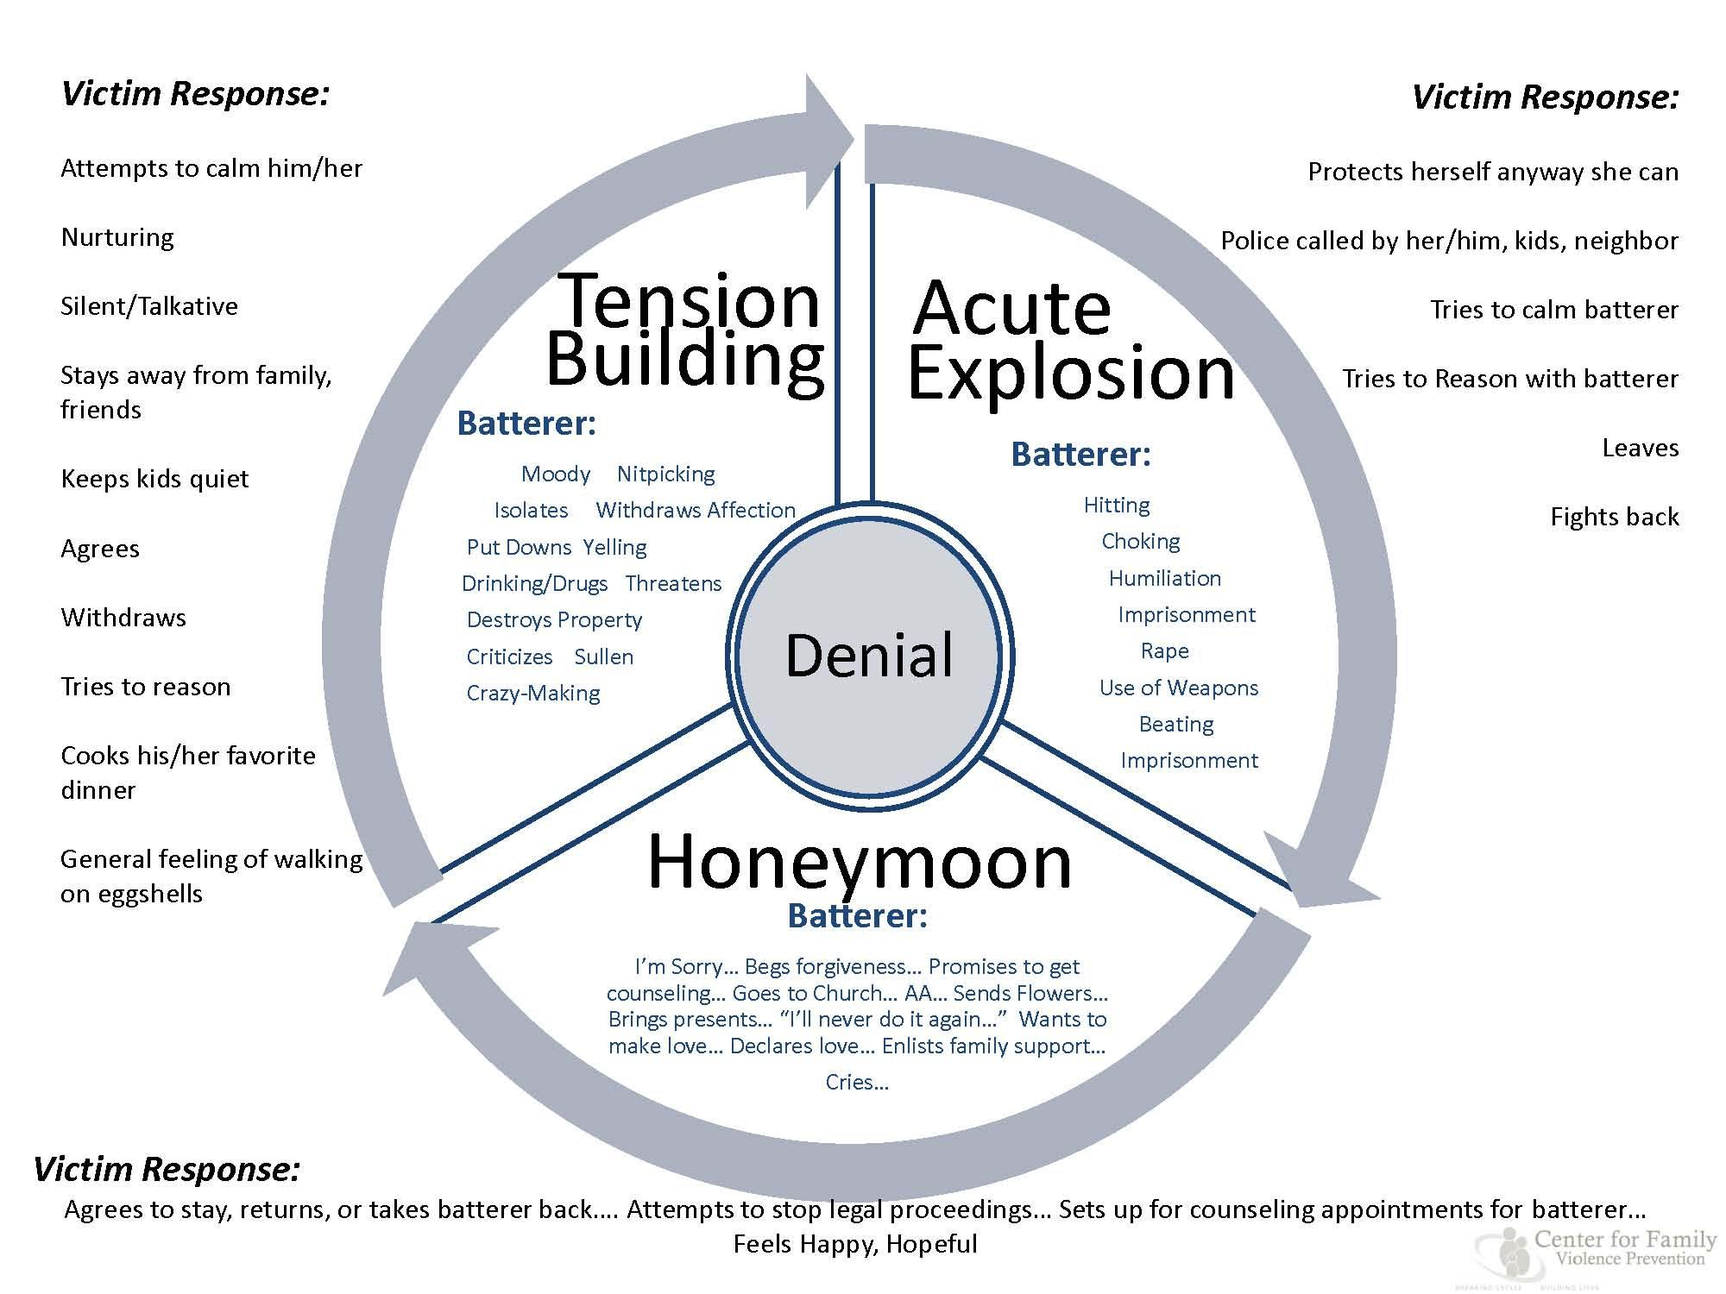

Slide 159
Myths
Myths of Intimate Partner Violence (IPV)

Slide 160
Coercive Control
Coercive control refers to abuse as a “strategic course of oppressive behavior,” meaning that battering is:
  rational, instrumental behavior and not a loss of control
  “ongoing” rather than episodic
  based on multiple tactics like violence, intimidation, degradation, isolation and control.
60-80% of women experience CC beyond the physical and emotional abuse

Slide 161
Some common examples of coercive control behavior
Isolating you from friends and family
Depriving you of basic needs, such as food
Controlling your finances
Controlling or having access to your bank account
Controlling where you work and the type of work you do
Controlling everything in your household – from house deeds to apartment leases, house phone, cell phones, utilities
Has everything in their name and being the sole person with authority over all accounts
Monitoring your time

Slide 162
Coercive Control is more insidious and is a calculated, controlled assault on the victim causing emotional and psychological harm to the victims. Victims are held hostage by the Coercive Control and live in fear, terrified of what will happen next. Coercive Control with abusers does continue after the relationship ends because in many cases the victims are still tied to the abuser where they can be intimidated or harassed.
http://www.coercivecontrol.us/what-is-coercive-control/

Slide 163
More Examples of Coercive Control
Monitoring you via online communication tools or spyware
Taking control over aspects of your everyday life, such as where you can go, who you can see, what you can wear and when you can sleep
Depriving you access to support services, such as medical services
Repeatedly putting you down, such as saying you’re worthless
Humiliating, degrading or dehumanizing you
Physical Assault and Rape
Making threats or intimidating you to keep you from leaving, seeking help or speaking publicly about your abuse

Slide 164
Coercive Control and Children
Using Children in IPV

Slide 165
Psychopathic wife assaulters
40% of men who come into group treatment are diagnosed with antisocial behavior (Dutton (1995).
Central feature of antisocial personality disorder is a lack of emotional responsiveness and lack of conscience
Conscience is the ability to punish the self for violating one’s own standards of conduct.
The psychological syndrome of psychopathy includes the loss of the ability to imagine another person’s fear or pain or the dreadful consequences that might follow abuse.
Other key signs is shallow emotional responses and unrealistic future scenario.
Other violent with other people (unlike cyclical abusers)

Slide 166
Overcontrolled wife assaulters
30% of assaultive males
Appear distanced from their feelings and on psychological tests show a strong profile of avoidance and passive aggression.
Two types:
  Active type—sometimes characterized as “control freaks” who needs for extreme domination to others.
  Passive type—Distance themselves from their wives (partners), and the couples usually argue over the attainment of emotional contact.
BOTH OF THESE TYPES SHOW UP AND TRY TO BE GOOD CLIENTS
On psychological tests these men score high scores on one factor of abusiveness called dominance/isolation which includes a strict observance of sex roles, demands subservience, and isolates partner from resources.
Emotional abuse includes verbal attacks, and the denial of emotional resources.
  All forms of emotional abuse are coercive techniques to generate submission.

Slide 167
CYCLICAL/EMOTIONALLY VOLATILE WIFE ASSAULTER
Abandonment or engulfment—sense of danger from to much closeness or too much distance.
Constellation of feelings involving rage and jealousy
Blame and misinterpretation directed at partners, holding them responsible for their own feelings of despondency, making impossible demands on them and punishing them for inevitably failing.
These abusers NEED to shame and humiliate another human being, to finally obliterate their own shame and humiliation.

Slide 168

SErmons

Slide 169
The Incest Family System
Family: Public vs. Private Attachment problems, shame, disassociation, denial, unresolved loss and trauma, addiction, marital relationship problems
The Engagement Phase
The Sexual Interaction Phase
The Secrecy Phase
The Disclosure Phase
The Suppression Phase

Slide 170
Aggression-based Incest
Involves sexual anger as a way for the perpetrator to deal with frustration and disappointment in various aspects of life on both physical and psychological levels

Slide 171
Erotic-based Incest
Occurs in families that attach sexual meaning to everyday interactions among family members
  Behaviors such as voyeurisms, exhibitionism, sexual teasing, a lack of personal privacy and boundaries
  The behaviors may be so ingrained in family interaction patterns that it is largely invisible to those who are involved

Slide 172
Affectional-based Incest
Serves as a means to give and receive affection, usually in families that are significantly lacking in physical nurturing and other forms of affection
  The specialness of the relationship is emphasized
  Child may appear cooperative and compliant because force is rarely used
  Unless discovered or revealed it will be interrupted by developmental phase (e.g. dating) or the father becomes interested in a younger sibling

