Slide 1
Psalms

Slide 2
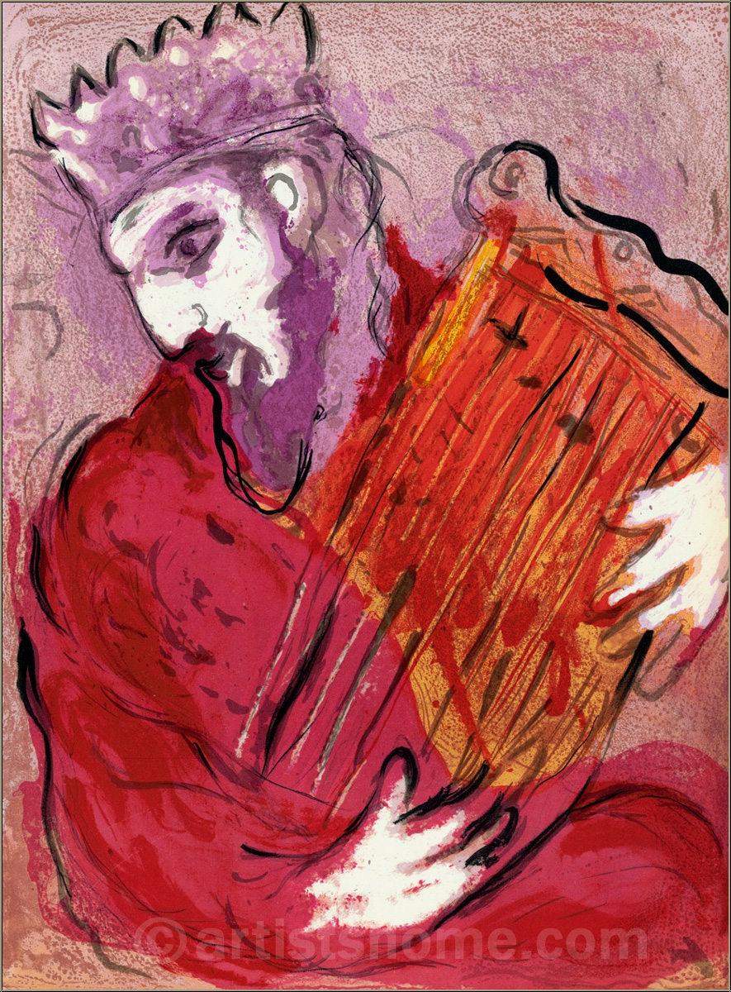

Slide 3
Clues to another origin
Ps 74
Ps 137
Ps 126
Ps 66:13-15
Ps 118
Ps 136
Ps 150
superscriptions (introductory headings) to Pss 4, 5, 6

Slide 4
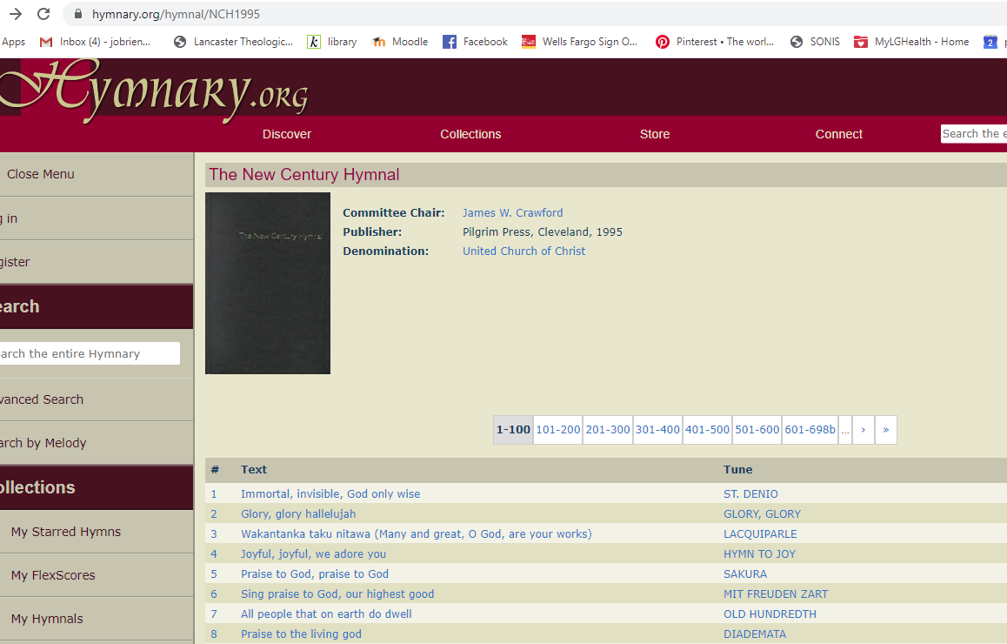

Slide 5
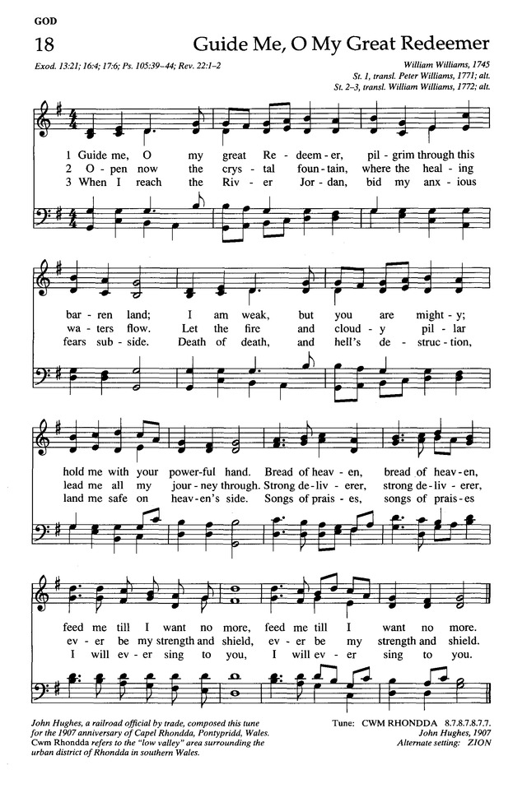

Slide 6
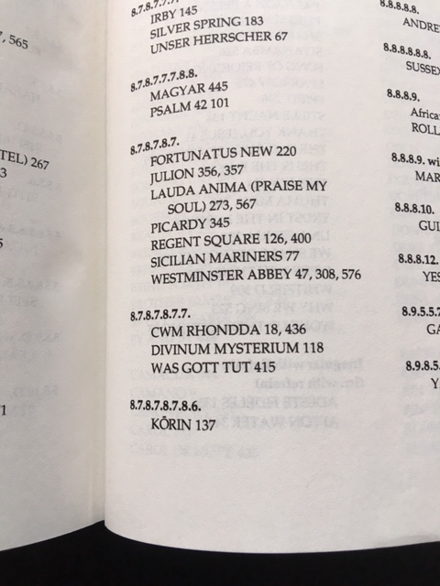

Slide 7
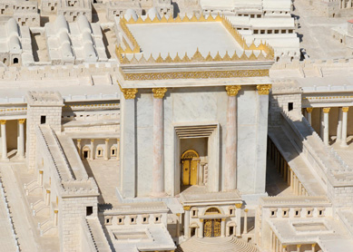

Slide 8
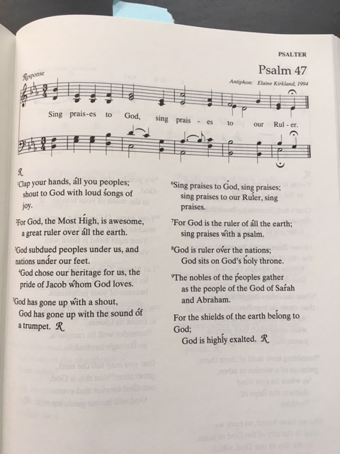

Slide 9
Clues to another origin
superscriptions (introductory headings) Pss 4, 5, 6

Slide 10
Clues to another origin
Psalm “forms” (Collins 316)

Slide 11
The Form of Lament Psalms
(source: http://www.cresourcei.org/psalmgenre.html#Lament)
I. Address to God, Invocation
a) first person address to God (I, you)
b) an initial plea
II. Complaint to God
a) description of problem, questions asked of God
b) crisis of any kind; in penitential psalms it is sin
c) claim of innocence
d) often includes an initial plea for help
e) condemnation of "wicked" or "enemy"
III. Affirmation of Trust
a) "But as for me" or "Nevertheless"
b) turning point of the psalm; theological focus
IV. Petition
a) plea for God’s intervention
b) often uses the words "save" or "deliver"
V. Acknowledgment of Response
a) assurance of hearing
b) vow of praise, worship
VI. Doxology: blessings, praise

Slide 12
Poetry: Parallelism
Ps 24

Slide 13
Poetry: elastic language
Ps 22

Slide 14
Assignment
Review the form of the communal lament in the Psalms (Collins).
Follow the outline of the lament psalm to write a communal lament our current situation. (My slide is for the individual lament: just change the “I to “we”.) And/or choose one of the communal laments (Collins chart p. 316) and modify it for today.

Slide 15
for additional reading:
Denise Dombkowski Hopkins, Journey through the Psalms
Lament: Reclaiming Practices in Pulpit, Pew, and Public Square

