Slide 1
Cross – Generational Communication
By Joslin Kearse

Slide 2
Introduction
Cross-Generational Communication
The interactions between parishioners of differing generations in the church
The Traditionalists, Baby Boomers, Generation X, Generation Y and Generation Z
Each have generally distinct communication styles
Conflicts that can occur
Benefits of intergenerational church

Slide 3
Objectives
Increase knowledge and understanding of five generations
Enhance comprehension of main communication issues
Promote benefits of team building with each generation

Slide 4
Traditionalists
Born between 1927 and 1945
The Silent Generation
Characteristics
Hardworking, do for self attitude
Dedicated, patriotic
Respect authority
Institutional knowledge
Communication Style
Face-to-face
Formal or hand written letter

Slide 5
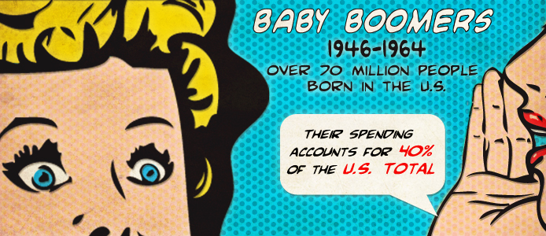
Boomers Characteristics
Born between1946 – 1964
Born into a transition phase
Characteristics
Workaholics
Consensual
Team player
Open to change
Communication Style
Prefer one – on –one discussions
Perceive their “boss” or “leader” as their colleague
Notes:
-All they do is work . Work is their life. They want to fulfill their desires. They strive to perfect their craft.
-They have a consensual leadership style: meaning that they are more accepted and their leadership is common its accepted. For example: you have two boomers working together, one boomer tells the other to get the project finish by today. The other boomer accepts that as a order. It’s a level of respect . Boomers beseech input but on the other hand reverts to authoritarian. They can be flip floppy which can result to confusion in the workplace
-This generation is comfortable in an environment that brainstorms issues. In the workplace you have situations that you need to sit down and discuss. Baby boomers are more accepting to sit down, face to face conversations.
-

Slide 6
Generation X
Born between1965-1980
The Latch-key Kids
Characteristics
Self-reliance
Dislike micromanagement
Communication Style
Prefer Communication on their terms
Blogging, Online Forums, Email, Text, IM
Notes:
-Ambitious, they set goals so they can better their future. For example: Their job now, is not what they expect their career job to be. They seek for higher opportunity.
-So if a manager has a new job position in the workplace. Gen Ys are the ones that go for it, and apply. Again, because they want to advance. They take advantage of what is being offered.
-Get the work done, but they want to have with the position they have. Gen Ys grew up in a multicultural and diverse era. Experienced a lot of new trends, new technology, social networks, the internet. Gen Ys bring creativity in the workplace because they’re surrounding w/ various aspects in which they can incorporate their ideas and bring it to the table.

Slide 7
Generation Y
Born between1981-1995 or 1999 (sources vary)
The Millennials
Born into a generation of advanced technology
Characteristics
Very goal oriented
Participative
Creative
Determined
Communication Style
Communicate through technology
Email, Text, IMs, Posts, DMs and Tweets
Notes:
-Ambitious, they set goals so they can better their future. For example: Their job now, is not what they expect their career job to be. They seek for higher opportunity.
-So if a manager has a new job position in the workplace. Gen Ys are the ones that go for it, and apply. Again, because they want to advance. They take advantage of what is being offered.
-Get the work done, but they want to have with the position they have. Gen Ys grew up in a multicultural and diverse era. Experienced a lot of new trends, new technology, social networks, the internet. Gen Ys bring creativity in the workplace because they’re surrounding w/ various aspects in which they can incorporate their ideas and bring it to the table.

Slide 8
Generation Z
Born after 1996 or 2000 (sources vary)
The iGen
The children of Gen X and Gen Y
Characteristics
Now breaking into the workplace and market place
Projected to be the fastest growing generation
Most of what we know is inferred – we will have to wait
Communication style
Highly connected with a prolific use of social media

Slide 9
Communication Barriers
Traditionalists
E-mail, Fax, Texting
Cell phones (primarily used for emergency only)
Social networking sites
Baby Boomers
Social networking sites
Blogging
Texting
Technophobia

Slide 10
Barriers Continued
Generation X
Face to face communication
Team discussions (better one on one or alone)
Difficulty with communicating up or down a generation
Generation Y
Face to face communication
Telephone conversations
Professional or even casual letter writing
Generation Z
Face to face communication
Telephone conversations
Professional or even casual letter writing
Working absent of technology

Slide 11
Fostering Communications
Generational differences matter
Get past generational differences
Mindset strategies
Show interest
Value differences, learning opportunities
Be mindful of your prejudices
See the individual
Show empathy
Behavioral strategies
Be flexible in communications
Be clear
Employ active listening, verbal and nonverbal cues
Be respectful

Slide 12
Conclusion
Better understanding of each generation
Communication style
Communication barriers
How to foster improved communications
Questions?

Slide 13
References
Different Generations Have Different Communication Styles and Different Tools. TechTeachToo. Retrieved on November 25, 2012 from http://techteachtoo.com/e-mail/different-generations-have-different-communication-styles-and-different-tools/
Strategies for Cross Generational Relationship building. Culturosity. Retrieved on October 31, 2012 from http://www.culturosity.com/articles/cross-generationalrealtionshipbuilding.htm

