Slide 1
Checking in with you

Slide 2
Checking in on learning
The Deuteronomistic History

Slide 3
Its content
Brief outline

Slide 4
Assessing David
1 Samuel 17

Slide 5
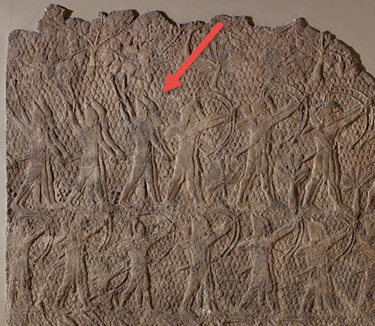
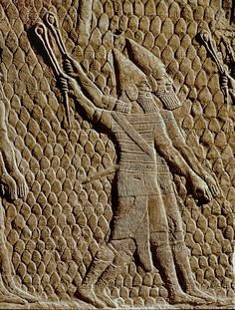

Slide 6
2 Samuel 7
“Second Samuel 7 is one of the key passages in the Hebrew Bible.” (Collins, p. 156)

Slide 7
2 Samuel 7
Davidic
dynasty
Jerusalem (Zion)
Temple

Slide 8
Assessing David
2 Samuel 11
Does the narrator approve?

Slide 9
Assessing David
2 Samuel 12
Does the punishment end with the death of the child?

Slide 10
Kings and the law
Is DtrH pro-monarchy or pro-Law?
Prophets vs. kings
Samuel vs. Saul
Nathan vs. David

Slide 11
Evaluating Solomon
The good
Wisdom
Temple

Slide 12
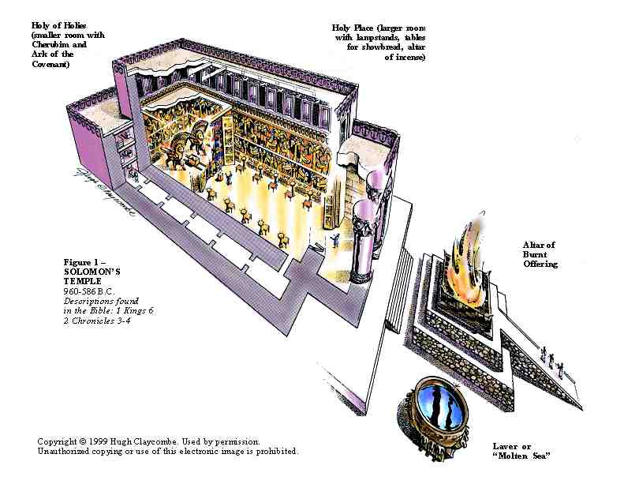

Slide 13
Evaluating Solomon
Compare 1 Kgs 4:7; 5:13 with 1 Sam 8

Slide 14
Evaluating Solomon
According to the Deuteronomistic Historian, how and why did the United Monarchy split into two kingdoms? What role did Solomon play in this split?
1 Kings 11

Slide 15
Other factors in history?
“The issue that sparked the revolt was the oppressive practice of forced labor, or corveé, introduced by Solomon.” (Collins p. 175)

Slide 16
Social legacies of Monarchy
political centralization
strengths: resist foreign armies; secure territory
weaknesses: need to support nonproductive labor
social stratification
scribes, army, court prophets, priests (roles for women?)
shifts in land tenure
heavy taxation and land seizure
foreign trade, diplomacy, war
international players. “like all the other nations...”

Slide 17
1-2 Kings: International relations
A timeline (Collins, p. 179)

Slide 18
1-2 Kings: The Fate of the Kingdoms
Outside the canon: the political realities of the ancient Near East in the 9th-6th centuries BCE

Slide 19
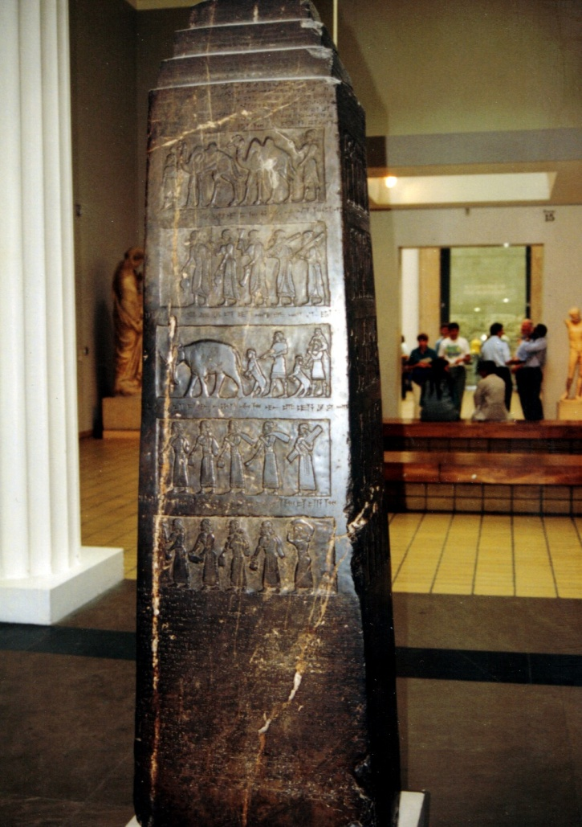

Slide 20
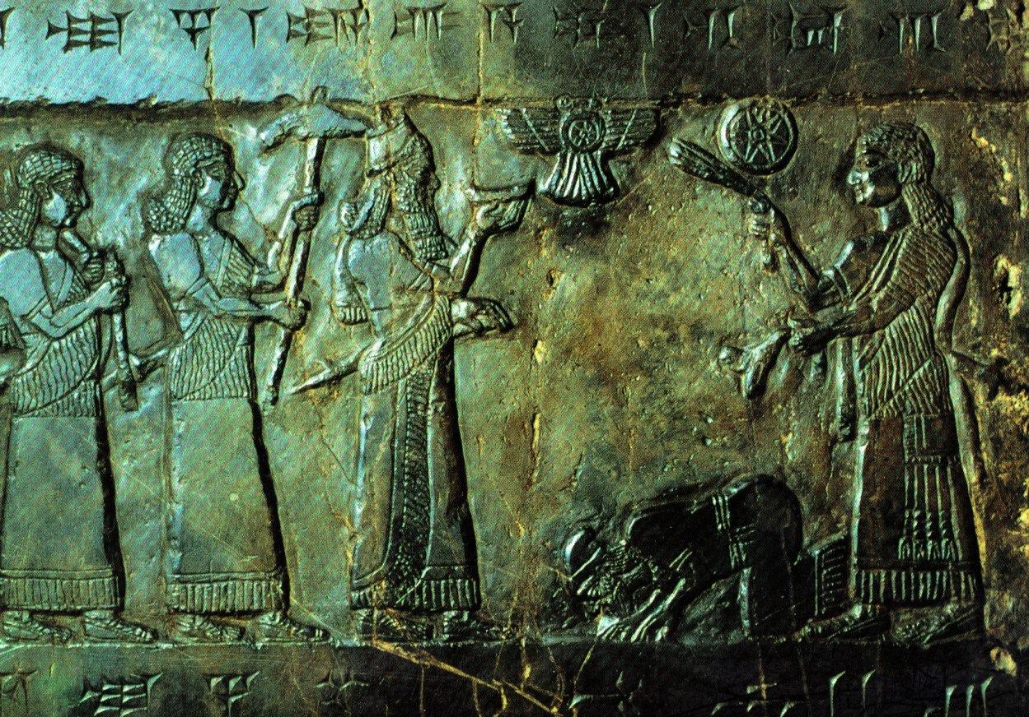

Slide 21
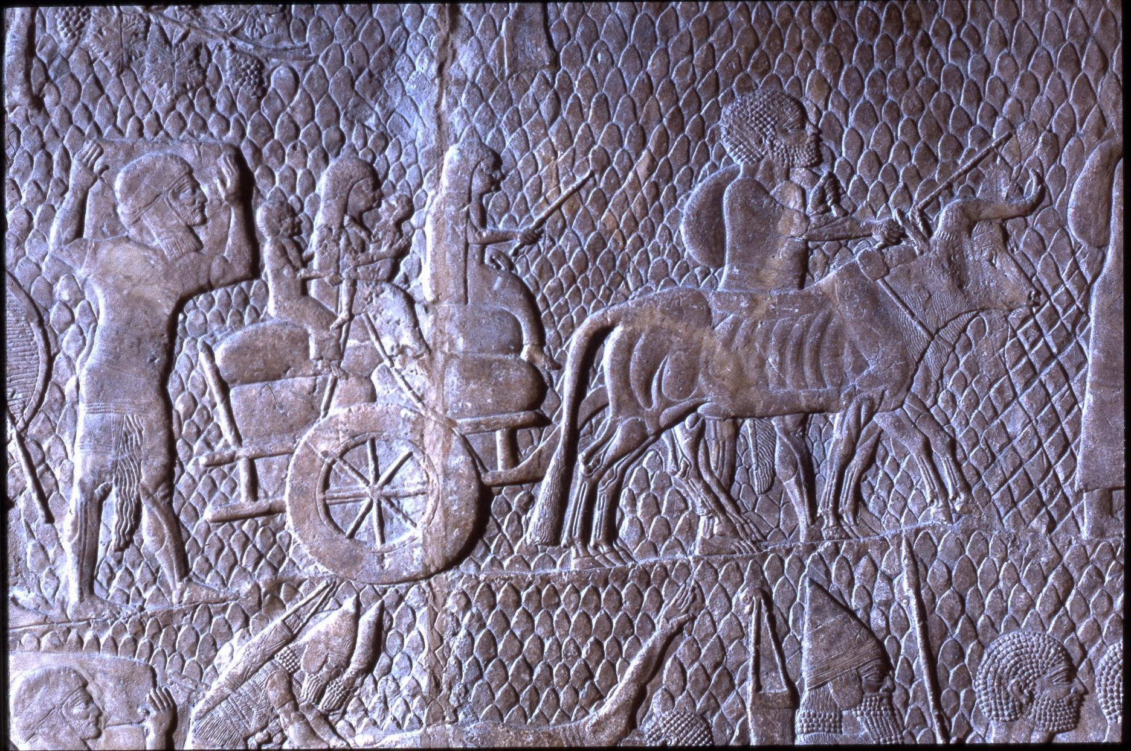

Slide 22
Theological readings of history
Why did Israel (north) fall?
“The Deuteronomists were primarily interested in a theological explanation.” (Collins, p. 188)
2 Kings 17

Slide 23
Theological readings of history
Why did Judah (the south) fall?
“The Deuteronomistic explanation of these disastrous events is simple, even simplistic. . .” (Collins, p. 192)

Slide 24
Dtr as a Loser’s History
“While history may be written by the victors, it is often the losers who live to tell its tale.”
(Jacob Wright, “A Nation Conceived in Defeat”)

Slide 25
Evaluating DtrH’s theology
“It was a merit of this explanation that it encouraged the Jewish people to look to themselves for the cause of their misfortunes, rather than to pity themselves as the victims of history. But ultimately, this explanation of history would not prove satisfactory. It placed too much blame on the victims. [Some of the most creative and powerful voices in the Hebrew Bible will challenge and undermine this theology of history].” (Collins, p. 192)

Slide 26
Thomas W. Mann. The Book of the Former Prophets. Cascade, 2011

Slide 27
So What?
Does knowing how and why DtrH was composed affect the way you understand it?
The way you will preach or teach it?
The way you will use it to interpret your own experience?

Slide 28
Upcoming assignments

