Slide 1
Our Terrain for Leadership

Slide 2
Otto Scharmer, Theory U, pg. 1
We live in an era of intense conflict and massive institutional failures, a time of painful endings and of hopeful beginnings. It is a time that feels as if something profound is shifting and dying while something else, as the playwright and Czech president, Vaclav Havel, puts it, wants to be born, “I think there are good reasons for suggesting that the modern age has ended. Today, many things indicate that we are going through a transitional period, when it seems that something is on the way out and something else is being painfully born. It is as if something were crumbling, decaying, and exhausting itself – while something else, still indistinct, were rising from the rubble.”

Slide 3
Otto Scharmer, Theory U, pg. 2
The crisis of our time isn’t just a crisis of a single leader, organization, country, or conflict. The crisis of our time reveals the dying of an old social structure and way of thinking, an old way of institutionalizing and enacting social forms.
Frontline practitioners – managers, teachers, nurses, physicians, laborers, mayors, entrepreneurs, farmers, and business and government leaders – share a sense of the current reality. They can feel the heat of an ever-increasing workload and the pressure to do more. Many describe this as running on a treadmill or spinning in a hamster wheel.

Slide 4
Stories and Maps
Our stories
“we cannot ... characterize behavior independently of intentions” (207)
“narrative history of a certain kind turns out to be the basic and essential genre for the characterization of human actions” (209)
basic distinction between "human beings and other beings" is that human beings "can be held to account for that of which they are the authors", and such an account must always be one of intelligible actions and not just actions (209)
Alasdair MacIntyre, After Virture

Slide 5
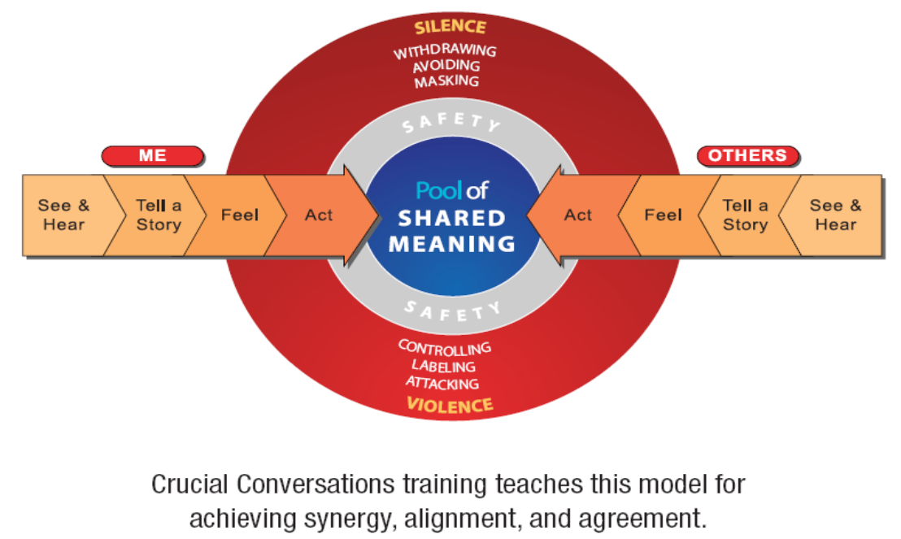
Stories and Maps
Our stories, 2 – Crucial Conversation

Slide 6
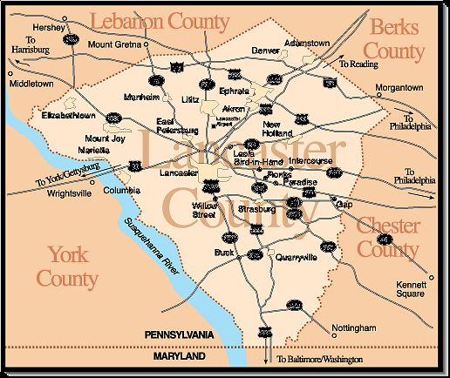
Stories and Maps
Our maps

Slide 7
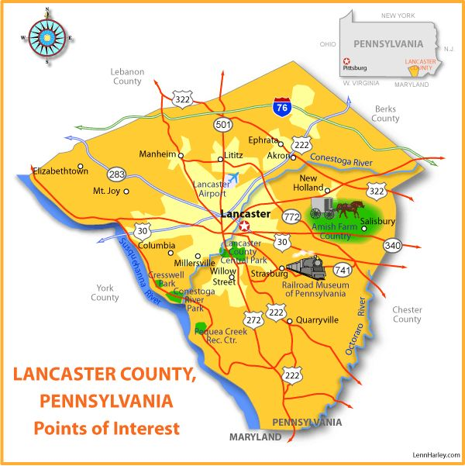

Slide 8
Stories and Maps
Maps of our imagination tell us who we are; provide for the geography of our identity, inform how we act (8)
Descriptions of the way the world works, culture rewards us for adhering to them (6)
Reflecting on maps helps us to see what shapes us (11)
Change in maps – more than an intellectual shift – also a deep emotional struggle (29)
Roxburgh, Missional Map-Making

Slide 10
Economic Terrain
Wealth
Poverty
Growing Disparity

Slide 11
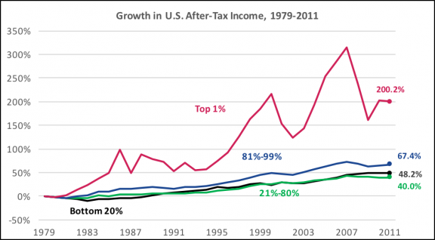
Source: Congressional Budget Office, The Distribution of Household Income and Federal Taxes, Figure 13, November 2014

Slide 12
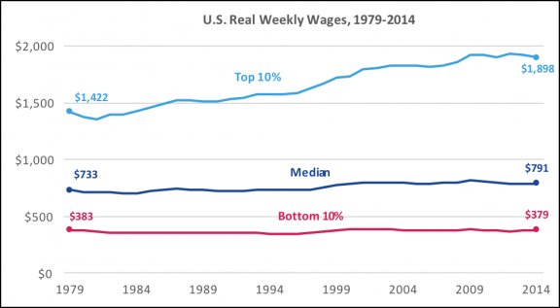
Source: A look at pay at the top, the bottom, and in between, Spotlight on Statistics, Page 2, U.S Bureau of Labor Statistics, May 2015

Slide 13
Spiritual Terrain
Secularization 1
Secularization 2
Secularization 3
How did we get here?
For the first time in human history a purely self-sufficient humanism came to be a widely available option. I mean by this a humanism accepting no final goal beyond human flourishing, nor any allegiance to anything else beyond this flourishing. Of no previous society was this true. Charles Taylor, pg. 18

Slide 14
Spiritual Terrain
Moral therapeutic deism…
Christian Smith and Melissa Lundquist Denton
National study of American Teenagers, culminated in book called Soul Searching: The Religious and Spiritual Lives of American Teenagers (2005)

Slide 15
1. A God exists who created and orders the world and watches over
human life on earth.
2. God wants people to be good, nice, and fair to each other, as
taught in the Bible and by most world religions.
3. The central goal of life is to be happy and to feel good about oneself.
4. God does not need to be particularly involved in one’s life except
when he is needed to resolve a problem.
5. Good people go to heaven when they die. (2-3)

Slide 16
Such a de facto creed is particularly evident among mainline Protestant and Catholic youth but is also more than a little visible among black and conservative Protestants, Jewish teens, other religious types of teenagers, and even many “nonreligious” teenagers in the United States. (5)
The language—and therefore experience—of Trinity, holiness, sin, grace, justification, sanctification, church, Eucharist, and heaven and hell appear, among most Christian teenagers in the United States at the very least, to be being supplanted by the language of happiness, niceness, and an earned heavenly reward. It is not so much that Christianity in the United States is being secularized. Rather more subtly, either Christianity is at least degenerating into a pathetic version of itself or, more significantly, Christianity is actively being colonized and displaced by a quite different religious faith. (57)
Christian Smith, On “Moralistic Therapeutic Deism” as U.S. Teenagers’ Actual, Tacit, De Facto Religious Faith

Slide 17
Changing Gender Roles
30.3 million women in the workforce in 1970 to 72.7 million during 2006-2010.
women made up 37.97 percent of the labor force in 1970 compared to 47.21 percent between 2006 and 2010.
leading occupations for women in 1970 were secretaries, bookkeepers, and elementary school teachers. In 2006-2010, the leading occupations were secretaries and administrative assistants, cashiers, and elementary and middle school teachers. Some of this is numbers-driven: there are many more jobs available for elementary and middle school teaching positions than there are for surgeons. Yet there are careers with similar numbers of job openings in other occupations that may not be for women traditionally.
The problem is that there doesn't seem to be any movement among occupations based on gender for both men and women. Men are holding on to the same types of jobs they had back in 1970: the leading occupations then were miscellaneous managers, truck drivers, and production supervisors. Today, they are truck drivers, miscellaneous managers, and freight, stock, and material movers.

Slide 18
Human Sexuality
Among all the changes going on in the world, none is more important than those happening in our personal lives – in sexuality, relationships, marriage, and the family
Anthony Giddens, Runaway World, pg 50.
The traditional family was above all an economic unit. Agricultural production normally involved the whole family group, while among the gentry and aristocracy transmission of property was the main basis of family. In medieval Europe, marriage was not contracted on the basis of sexual love, nor was it regarded as a place where such love should flourish.
Giddens, pg. 54

Slide 19
Most family life, however, has been transformed by the rise of the couple and coupledom. Marriage and the family have become what I termed in Chapter 1 shell institutions: they are still called the same, but inside their basic character has changed. In the traditional family, the married couple was only one part, and often not the main part, of the family system….The couple came to be at the centre of family life as the economic role of the family dwindled and love, or love plus sexual attraction, became the basis of forming marriage ties.
Marriage in never in the past based upon intimacy – emotional communication. No doubt this was important to a good marriage but it was not the foundation of it. For the couple, it is.
Giddens, pg. 58-59

Slide 20
Post-modernism
modern mind – characteristic – outlook of Francis Bacon that humans exercising the power over nature by means of discovery of nature’s secrets
Habermas calls the Enlightenment project – goal of the human intellectual quest to unlock the secrets of the universe in order to master nature for human benefit and create a better world
Rational management of life in order to improve human existence through technology
Knowledge is certain and rational
This is modernism – Stanley Grenz, Primer on Postmoderism, 2

Slide 21
Result – huge gains and huge losses
End result – post-modernism
Any interpretation of reality is an assertion of power
Knowledge is not objective
No quest for a supra-cultural, timeless, universal truth

Slide 22
Post-Christendom
In granting the Christian church special favors and privileges in the fourth century, the Roman Emperor Constantine ushered in the era of the church-state partnership that would profoundly shape European society and culture for centuries to come. As the protected and privileged religion of society, Christianity achieved unrivaled cultural dominance. The resulting cultures in Europe and later in North America became known as Christendom. Even though the legal structures of Christendom were removed in North America (i.e. the separation of the state), the legacy of this Constantinian system remained by means of powerful traditions, attitudes and social structures that could be described as “functional Christendom.”
In the age of Christendom, the church occupied a central and influential place in society and the Western world considered itself both formally and officially Christian. So when we speak of post-Christendom, we are making the point that the church no longer occupies this central place of social and cultural hegemony and Western civilization no longer considers itself to be formally or officially Christian. S. Michael Craven

Slide 23
Christendom is the correct designation for the synthesis forged after 313 C.E. by the Emperor Constantine and his successors. Christendom meant that Christianity became the recognized as the religion of the state, and the church functioned as the religious guardian of the society. Christendom, or the corpus Christianum, thereby became indistinguishable from society. Citizenship in society was synonymous with membership in the church, and baptism was a religio-political rite.
Wilbert Shenk, Write the Vision, pg 9-10

Slide 24
Mainline Protestantism is no longer the religious expression of American society, the culture’s de facto established church. The social and religious climate has altered dramatically, pushing denominations such as the PCUSA out of the center of American Christianity, and pushing Christianity itself to the margins of a culture that is increasingly secular, pluralistic, and indifferent to the institutional church.
http://www.pcusa.org/re-formingministry/about/whyecclesiology.htm

Slide 25
Post-Constantinianism
In each European country, the church was “established” as a state church – Anglican in England, Presbyterian in Scotland, Reformed in the Netherlands, Lutheran in Scandinavia and some of the German territories, Roman Catholic in most of Southern Europe, etc. It was difficult ot differentiate between political, cultural, and religious elements and activities, since they all merged into one. This made it completely natural for the first European colonizing powers, Portugal and Spain, to assume that they, as Christian monarchs, had the divine right
David Bosch, Transforming Mission, pg. 275

Slide 26
Globalization
The level of world trade today is much higher than it ever was before, and involves a much wider range of goods and services. But the biggest difference is in the level of finance and capital flows. Geared to electronic money – money that exists only as digits in computers – the world economy has no parallels in earlier times. In the new global electronic economy, fund managers, banks, corporations, can transfer vast amounts of capital from one side of the world to another with the click of the mouse. As they do so, they can destabilse rock-solid economies.
Shell institutions
Anthony Giddens,
Something from Risk Society?

Slide 27
Racism
The sufferings of black people during slavery are too deep for words. That suffering did not end with emancipation. The violence and oppression of white supremacy took different forms and employed different means to achieve the same end: the subjugation of black people. And Christian theology, for African Americans, maintained the same great challenge: to explain from the perspective of history and faith how life could be made meaningful in the face of death, how hope could remain alive in the world of Jim Crow segregation. These were the challenges that shaped black religious life in America.
James Cone, The Cross and the Lynching Tree, pg 2-3

Slide 28
Recent discussions about the plight of African-Americans – especially those at the bottom of the social ladder – tend to divide into two camps. On the one hand, there are those who highlight the structural constraints on the life chances of black people. Their viewpoint involves a subtle historical and sociological analysis of slavery, Jim Crowism, job and residential discrimination, skewed unemployment rates, inadequate health care, and poor education. On the other hand, there are those who stress the behavioral impediments of black upward mobility. They focus on the waning Protestant work ethic – hard work, delated gratification, frugality, and responsibility – in much of black America.
Cornell West, Race Matter, pg. 11

Slide 29
The proper starting point for the crucial debate about the prospects of black America is an examination of the nihilism that increasingly pervades black communities. Nihilism is to be understood here not as a philosophic doctrine that there are no rational grounds for legitimate standards or authority; it is, far more, the lived experience of coping with a life of horrifying meaninglessness, hopelessness, and (more important) lovelessness.
Cornell West, Race Matters, pg. 14

Slide 30
Racial Diversity
The US Census Bureau recently released population projections showing that non-Hispanic whites will no longer be the majority of the population in 2042 (US Census Bureau 2008b; Roberts 2008). Most media accounts of these forecasts neglect to report that whites (as opposed to non-Hispanic whites) are actually projected to remain the large majority (upwards of 70 percent in 2050) of the US population (for earlier accounts, see Pellegrini 2000; US Census Bureau 2004). Census Bureau projections by race are flawed, however, because they ignore the relatively high levels of intermarriage and the variations in racial and ethnic identities of mixed-ancestry descendants (Hirschman 2002; Perlmann 2002). More nuanced population projections, produced by the 1997 National Research Council Panel on the Demographic and Economic Impacts of Immigration, incorporate alternate assumptions about current and future trends in immigration, intermarriage, and identity choices (Smith and Edmonston 1997: Ch. 3). These projections, subsequently updated by Edmonston, Lee, and Passel (2002), also show a decline in the proportion of non-Hispanic whites, although not as rapid as in Census Bureau projections. Population projections by race are heavily dependent on the identity choices of persons of multiple racial and ethnic origins (ibid.: 249). Assuming current trends continue to 2050, about a quarter of Asian Americans and African Americans will have recent mixed ancestry, as will nearly half of all Hispanic Americans (ibid.: 246−247). These levels of racial and ethnic mixing and an increased awareness of multiracial ancestry are likely to reshape racial and ethnic boundaries in the coming decades.
Anthony Daniel Perez and Charles Hirschman, The Changing Racial and Ethnic Composition of the US Population: Emerging American Identities

Slide 31
At the same time our population is going gray, we’re also becoming multi-colored. In 1960, the population of the United States was 85% white; by 2060, it will be only 43% white. We were once a black and white country. Now, we’re a rainbow.
http://www.pewresearch.org/next-america/#Americas-Racial-Tapestry-Is-Changing

Slide 32
The typical North American response to our situation is to analyze the problem and find a solution. These solutions tend to be methodological. Arrange all the components of the church landscape differently, and many assume that the problem can be solved. Or use the best demographic or psychological or sociological insights, and one can redesign the church for success in our changing context.” Missional Church, pg. 2

Slide 33
Landscape of Leadership
Complex
Interesting
Ever shifting
Requires a multitude of skills
People skills
Hope
Interpretive skills
Curiosity
Learning

Slide 34
Geographic/Cultural Particularities
Something about saying yall, yuns, and sports teams

